Slide 1
An NSS Audio-Visual
Library Presentation
John Guilday Cave Preserve
Guilday Cave Preserve Management Committee (1992)
S628 81 Slides 2/4/2021

Slide 3
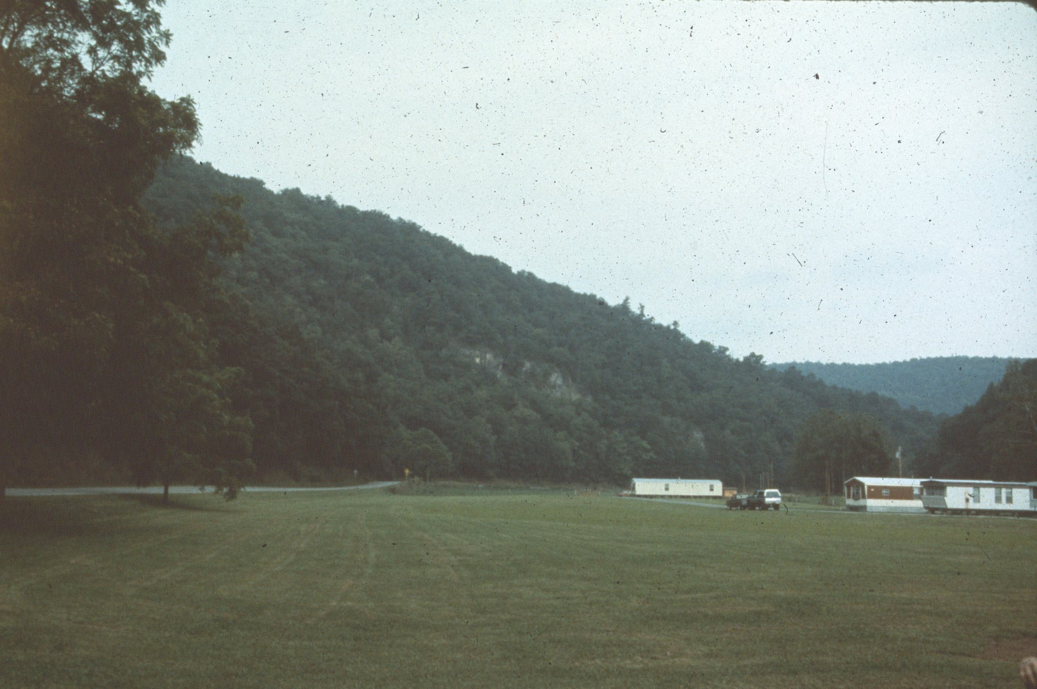
Notes:
The NSS John Guilday Cave Preserve is located along U.S. Highway 220 a few miles south of Franklin, West Virginia. It's named for John Guilday, a caver and paleontologist who died in 1982.

Slide 4
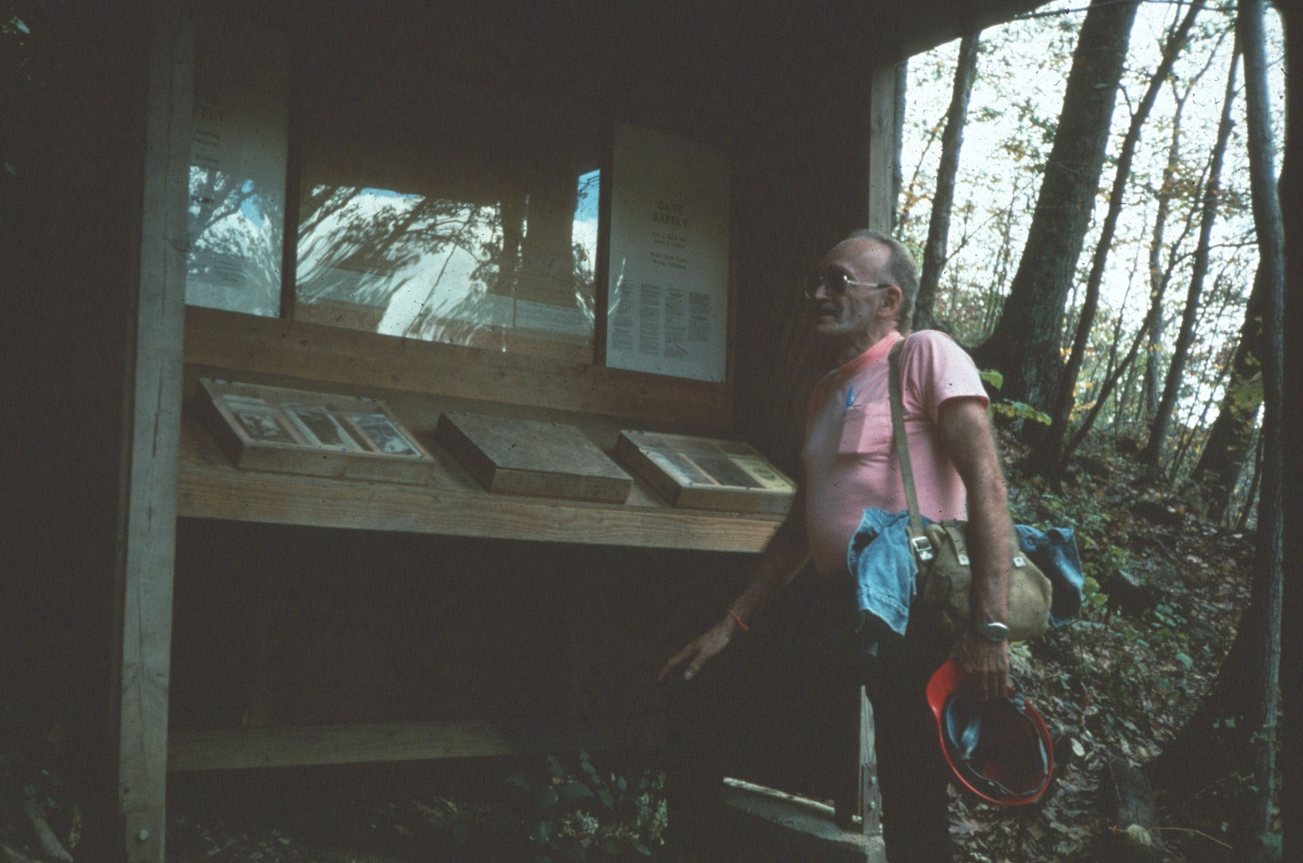
Notes:
Visitors are welcomed by a visitor booth with information about the property, the caves, and the NSS.

Slide 5
Notes:
New Trout is the first cave most people see when entering the property.

Slide 6
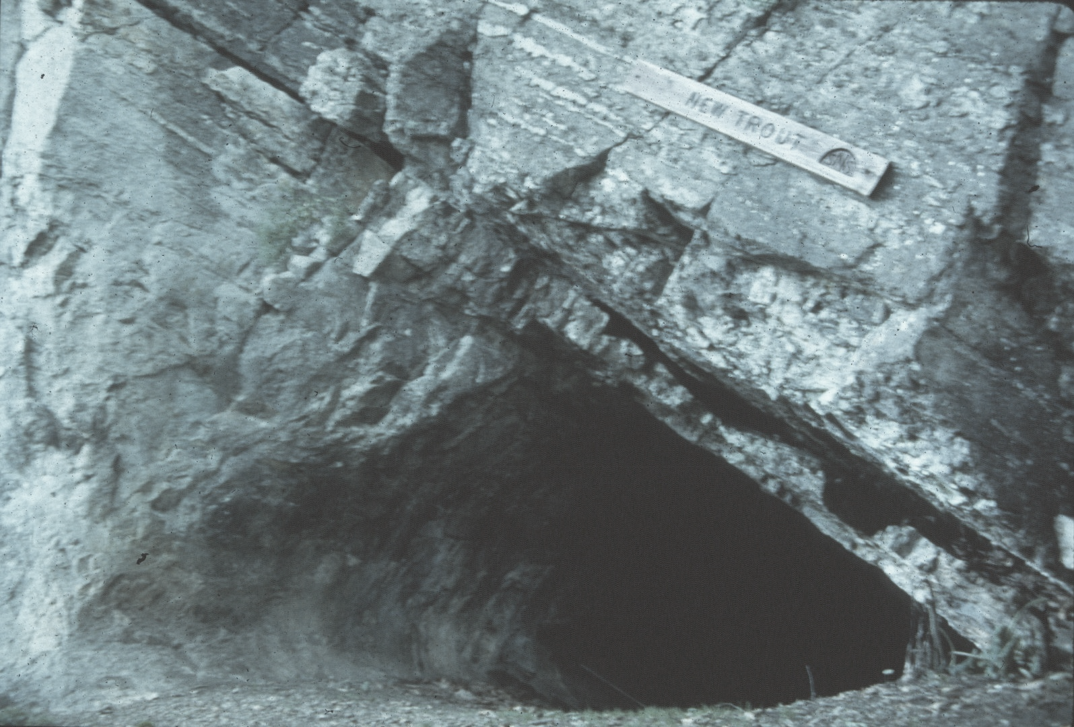
Notes:
It's entrance is in the flank of an anticline.

Slide 7
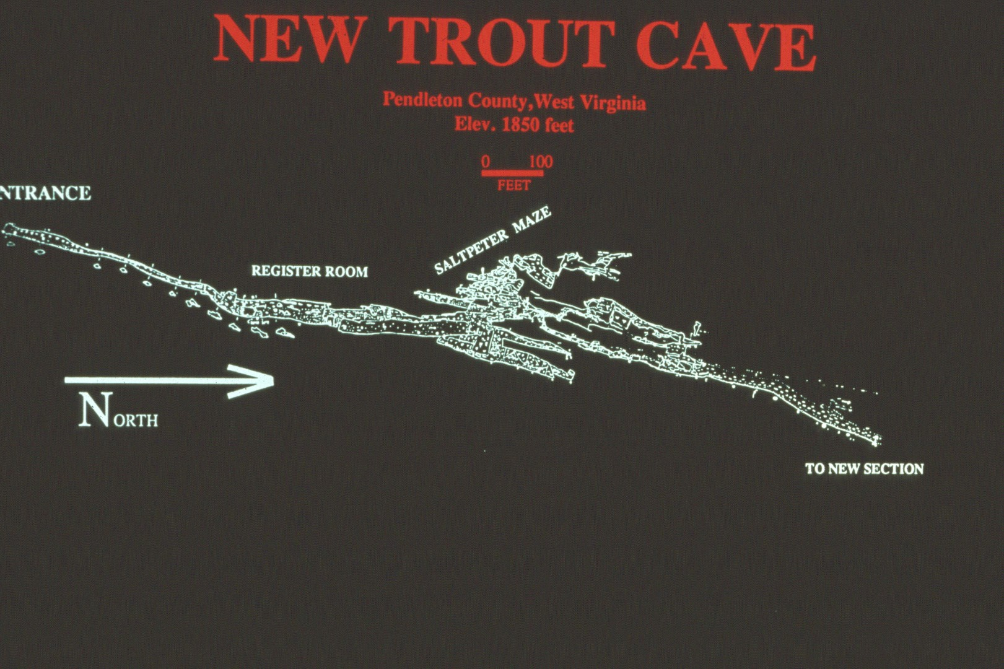
Notes:
This portion of the New Trout map shows approximately one half of the cave.

Slide 8
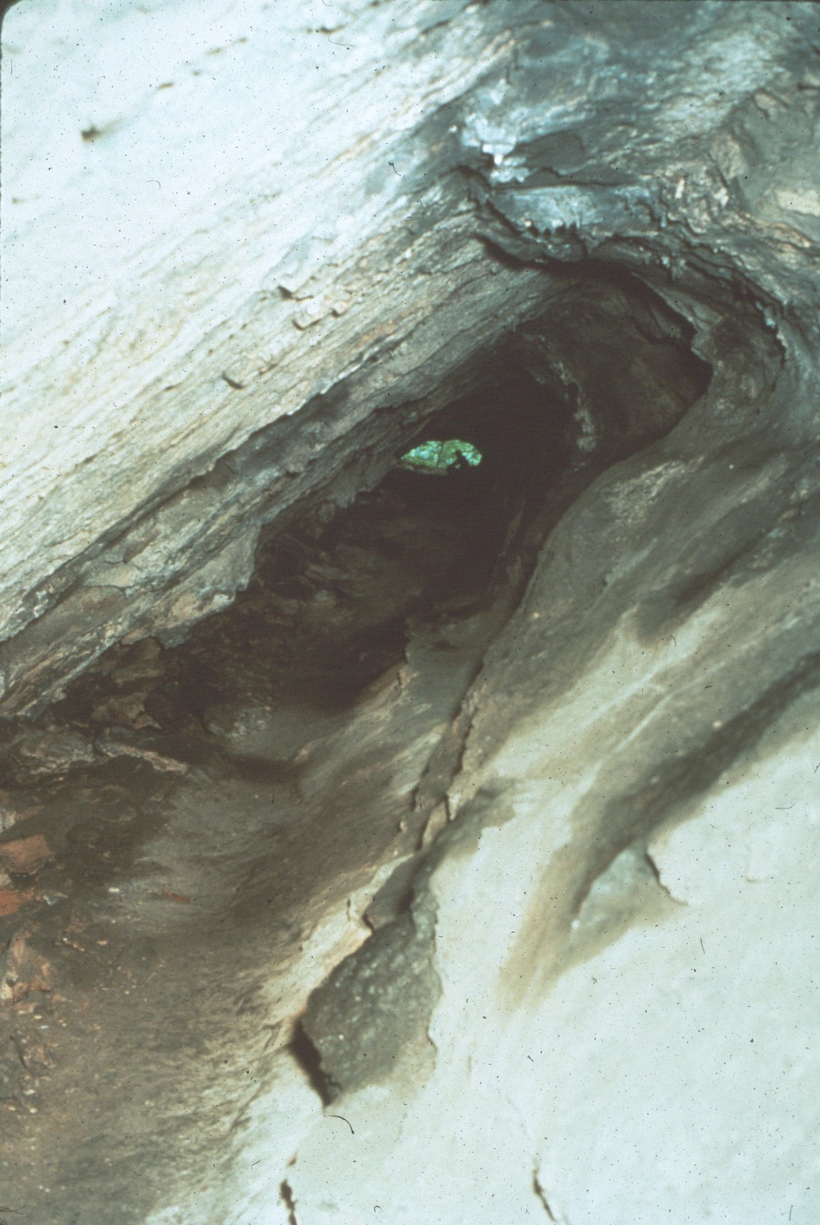
Notes:
Looking back to the entrance one views a typical cross section of New Trout.

Slide 9
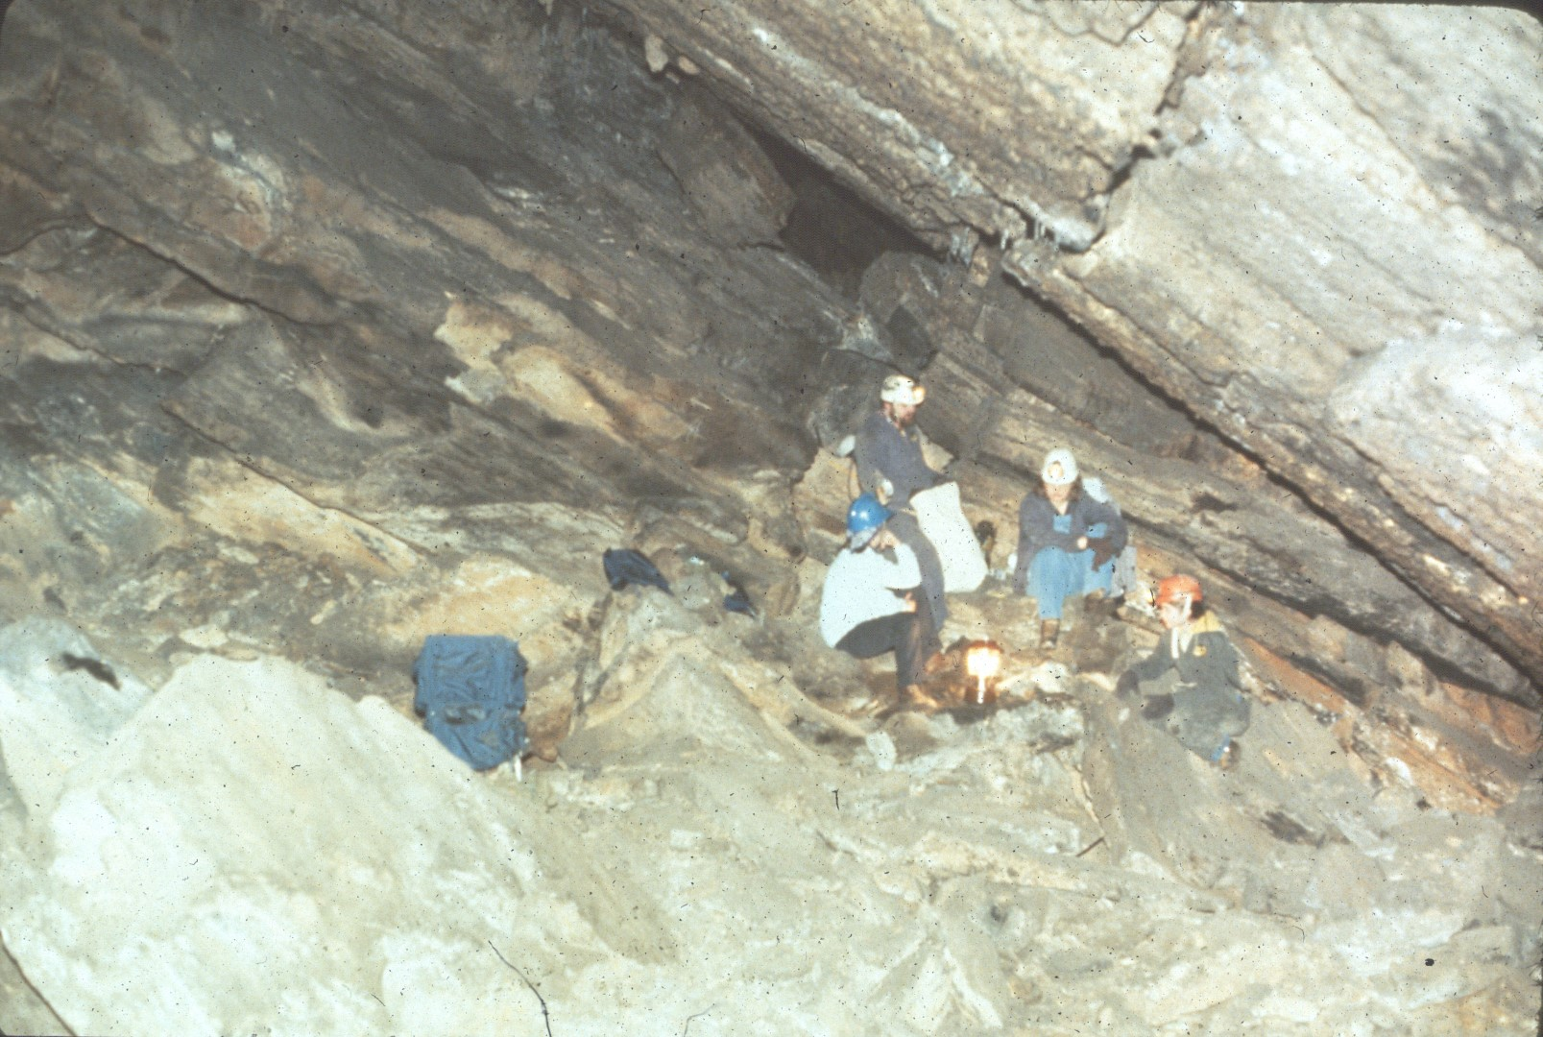
Notes:
Ray Garton and others have been studying several significant bone sites in New Trout since the 1970's.

Slide 10
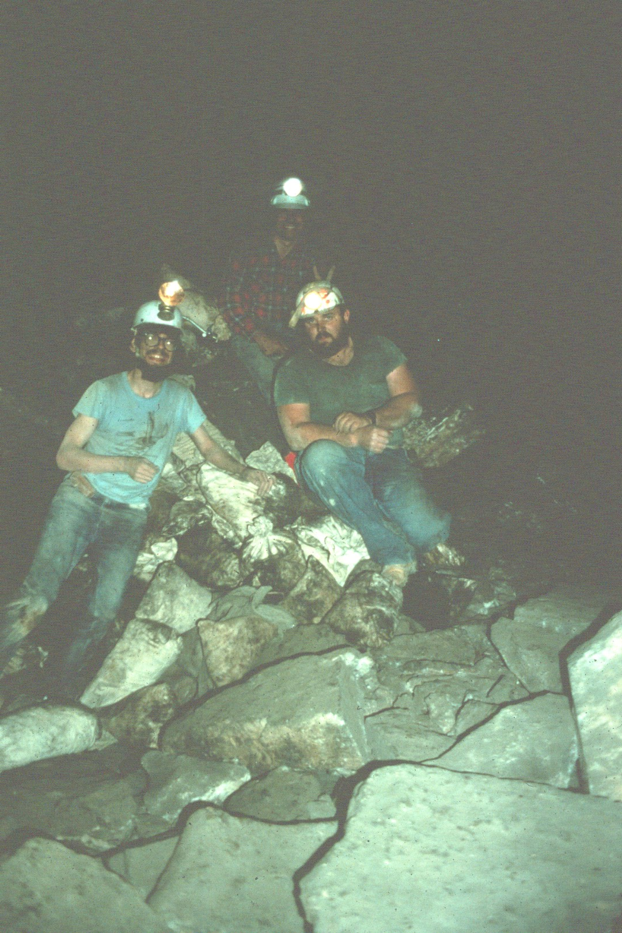
Notes:
Here are Fred Grady, Jia Gyorko, and Ray Gart on with a load of bone matrix.

Slide 11
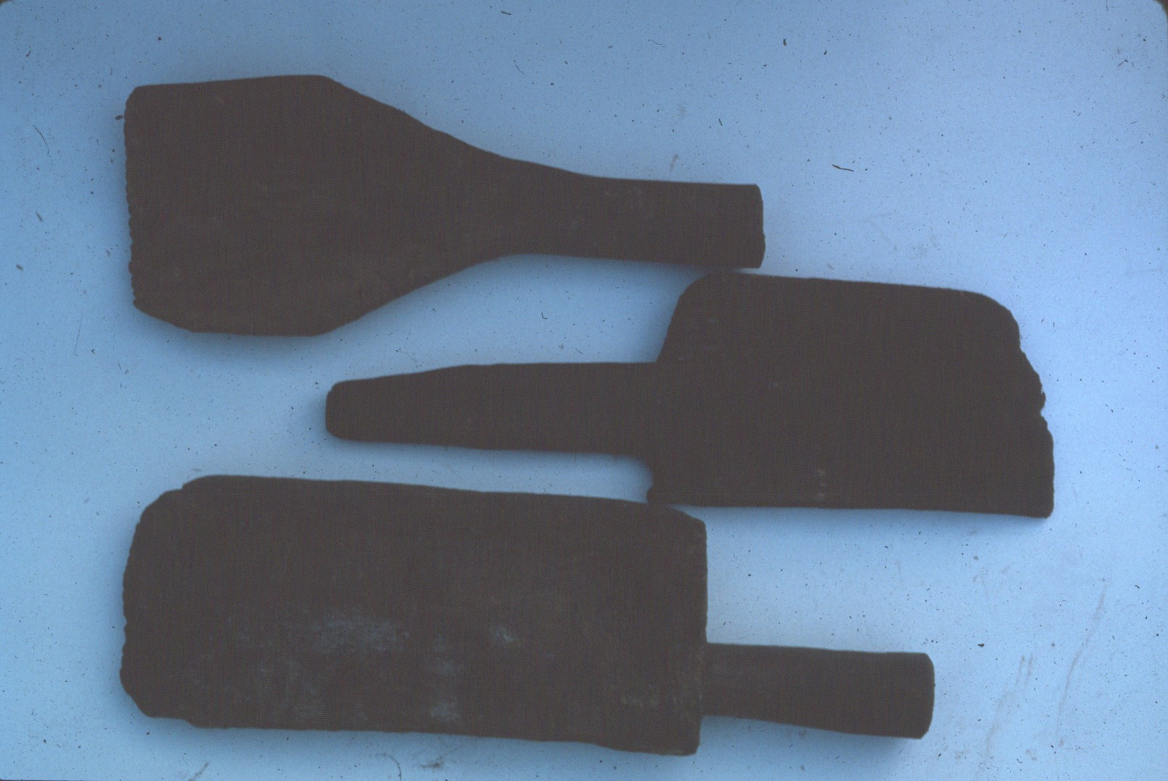
Notes:
New Trout was mined for saltpeter in the 1800's. These are some of the paddles found in the cave in the late 1980's. They are now located in the NSS museum.

Slide 12
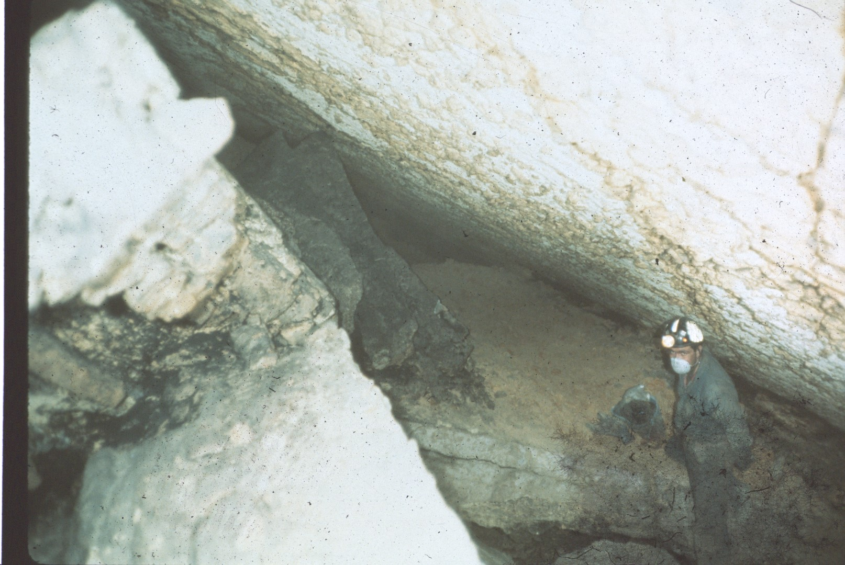
Notes:
The back of New Trout is very dusty . . .

Slide 13
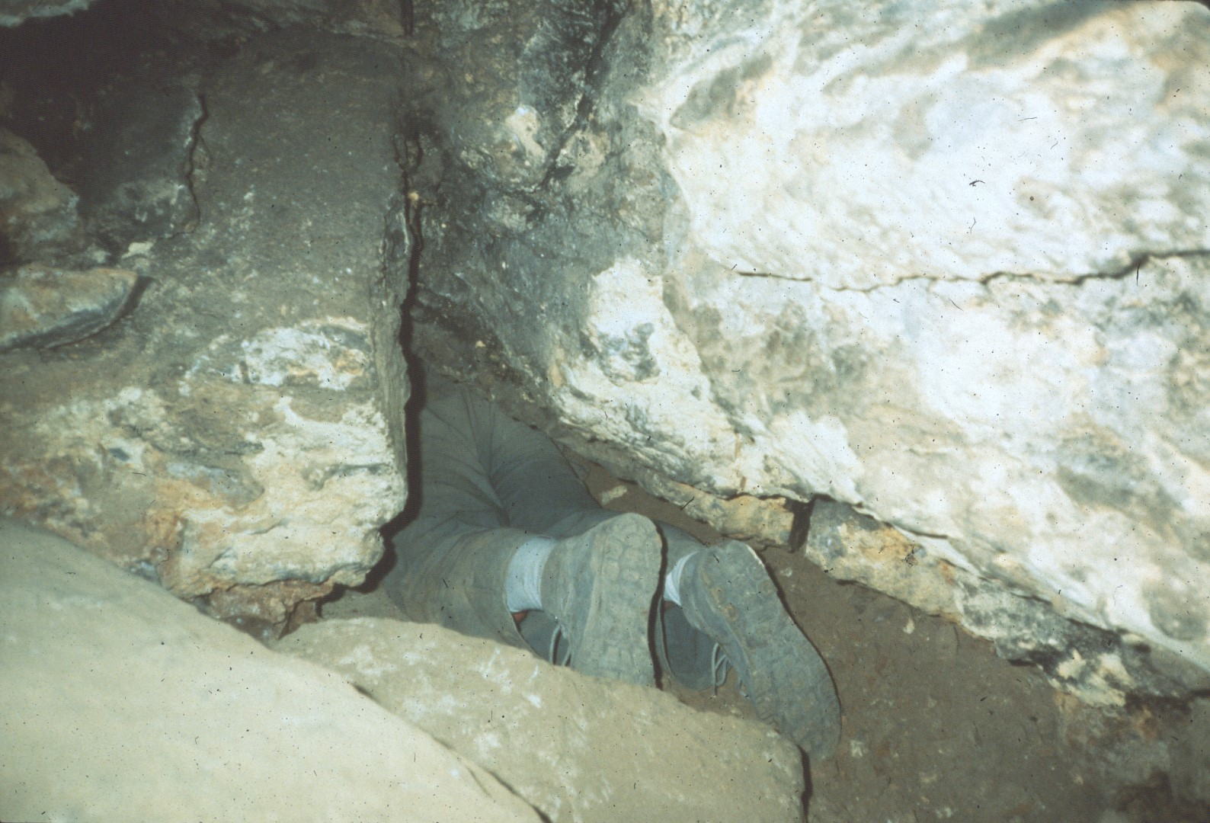
Notes:
and in some places small.

Slide 14
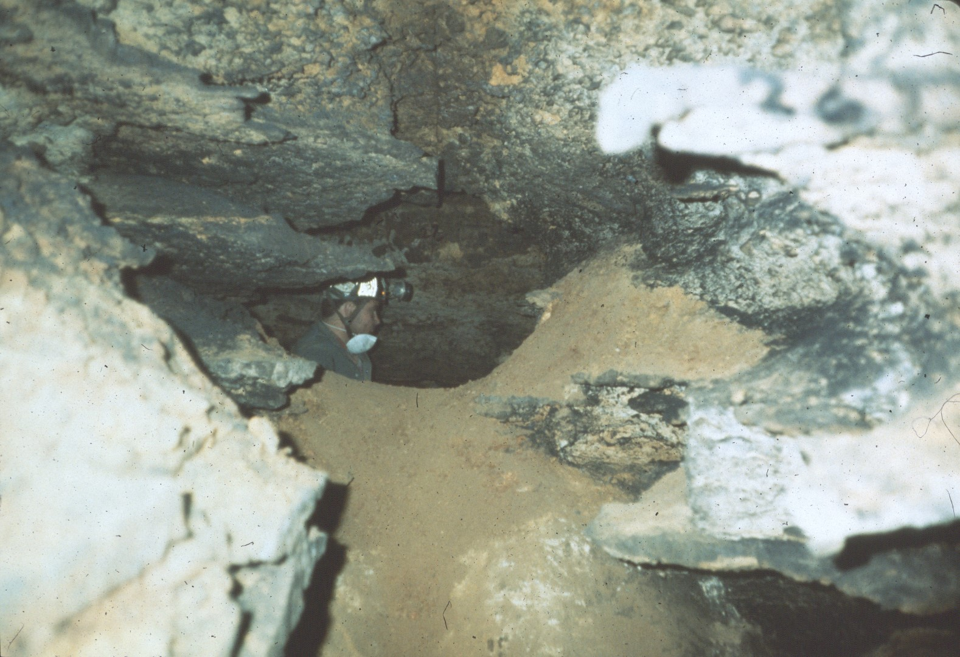
Notes:
New Trout has a breakdown maze. In 1990 a group of cavers became lost in the maze and had to be rescued. Their story was told in Reader's Digest.

Slide 15
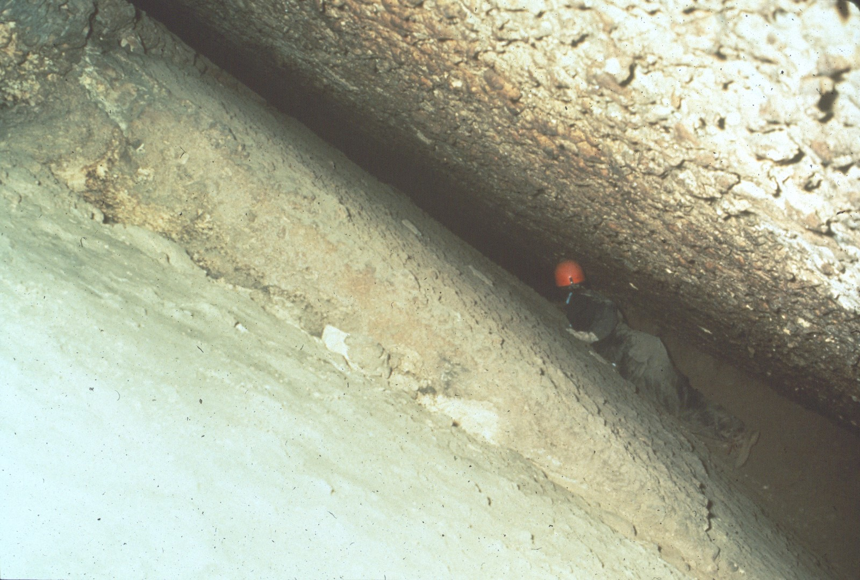
Notes:
In the back of the Historic Section the passage continues as a crack between bedding planes.

Slide 16
Notes:
In 1987 a way beyond the bedding plane crack was found which ultimately led to doubling the known extent of the cave.

Slide 17
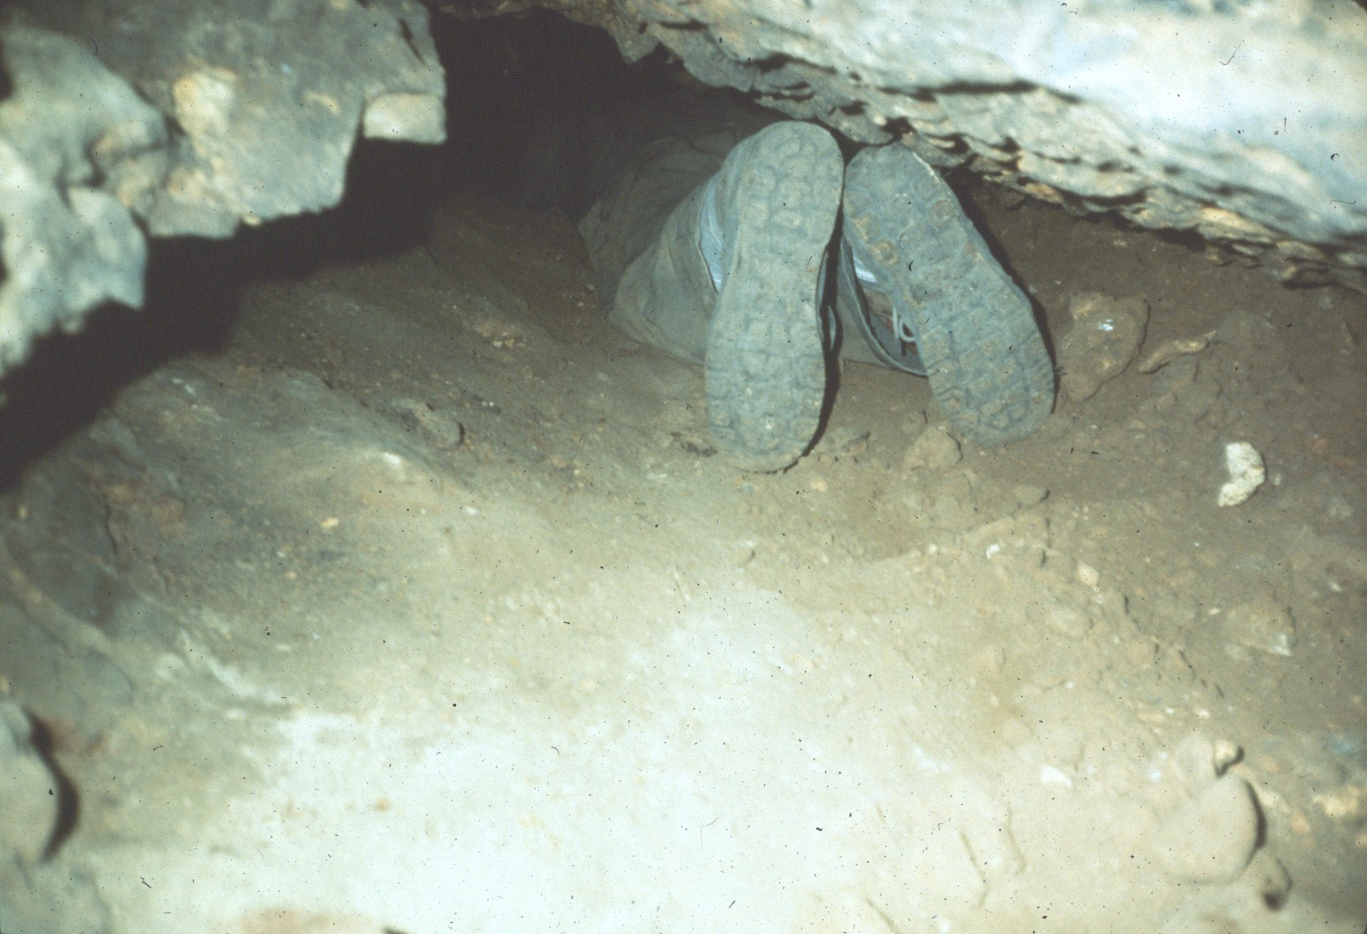
Notes:
The way was dug under the lower of the two bedding planes.

Slide 18
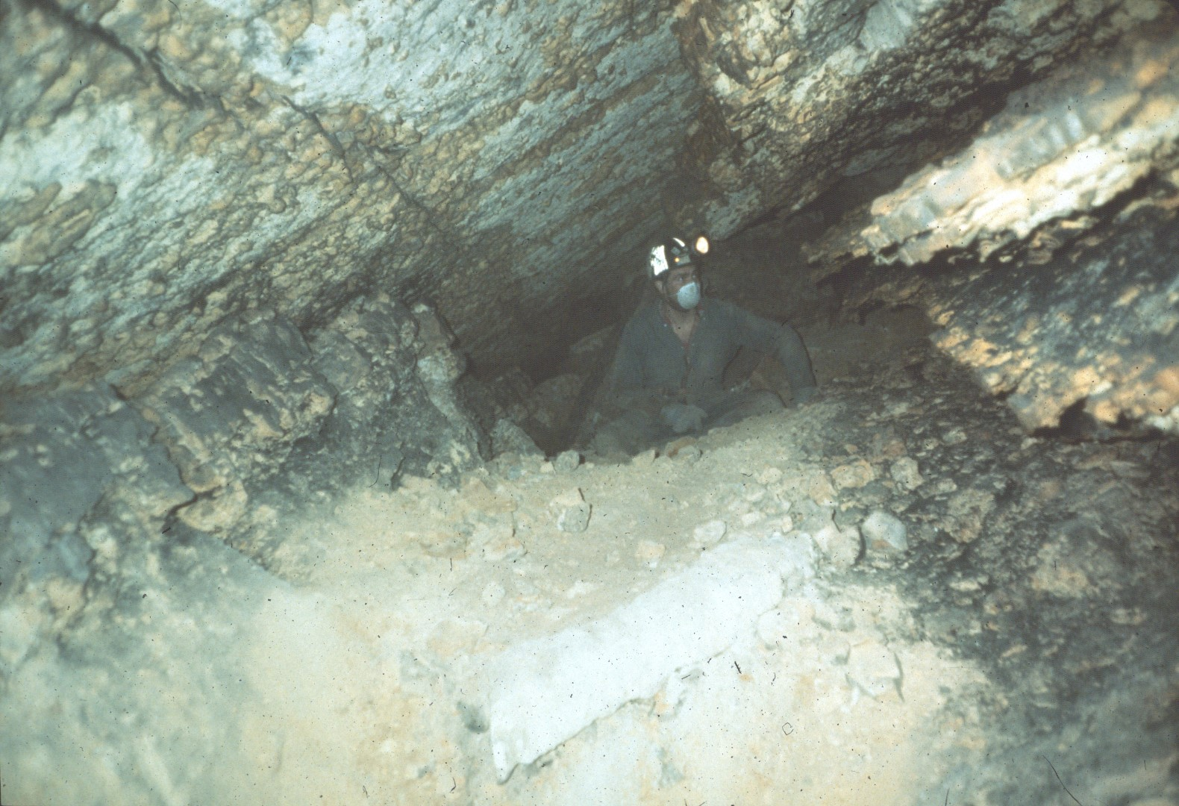
Notes:
Dust masks are required in this section because of the loose fine dirt.

Slide 19
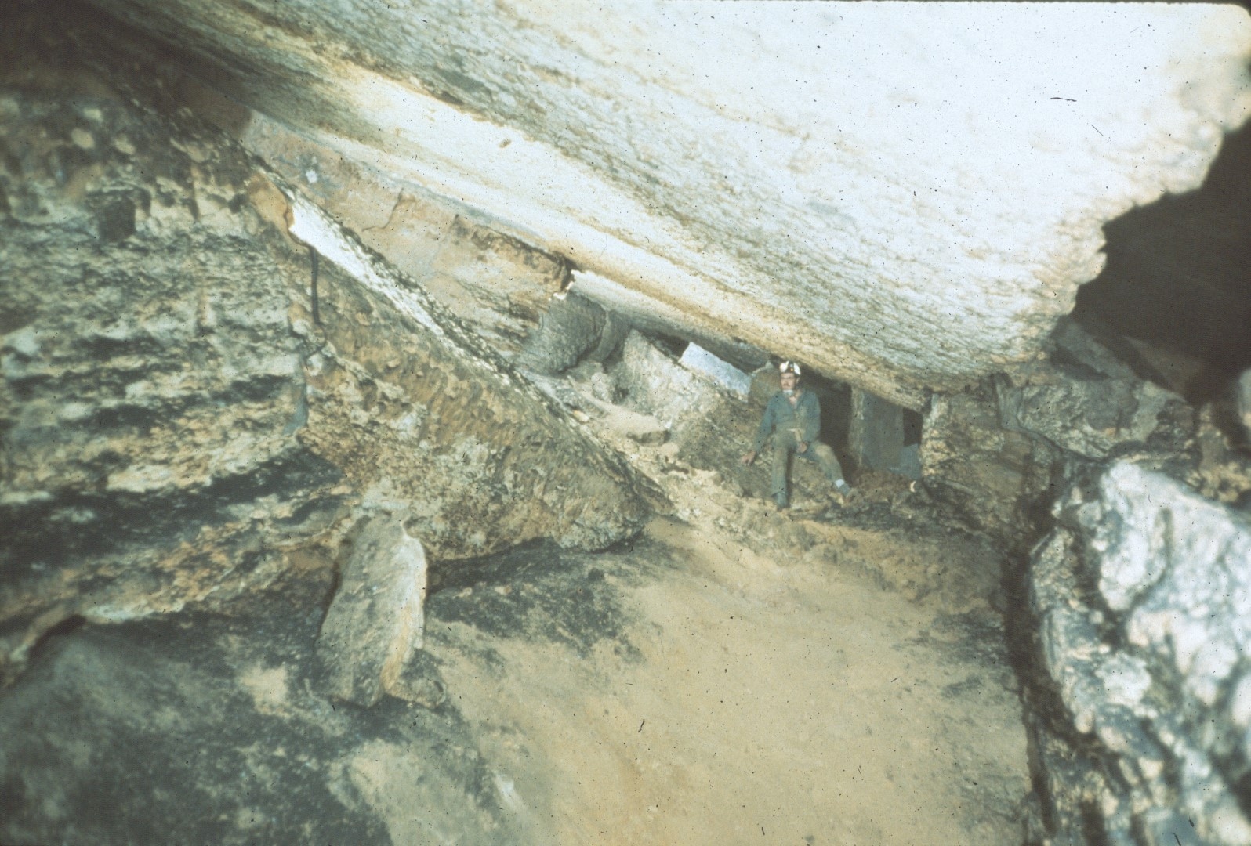
Notes:
One of the rooms beyond the dig, Thrush Hall, was named for a fungal infection contracted by Gordon Brace, the first person in the area without a dust mask.

Slide 20
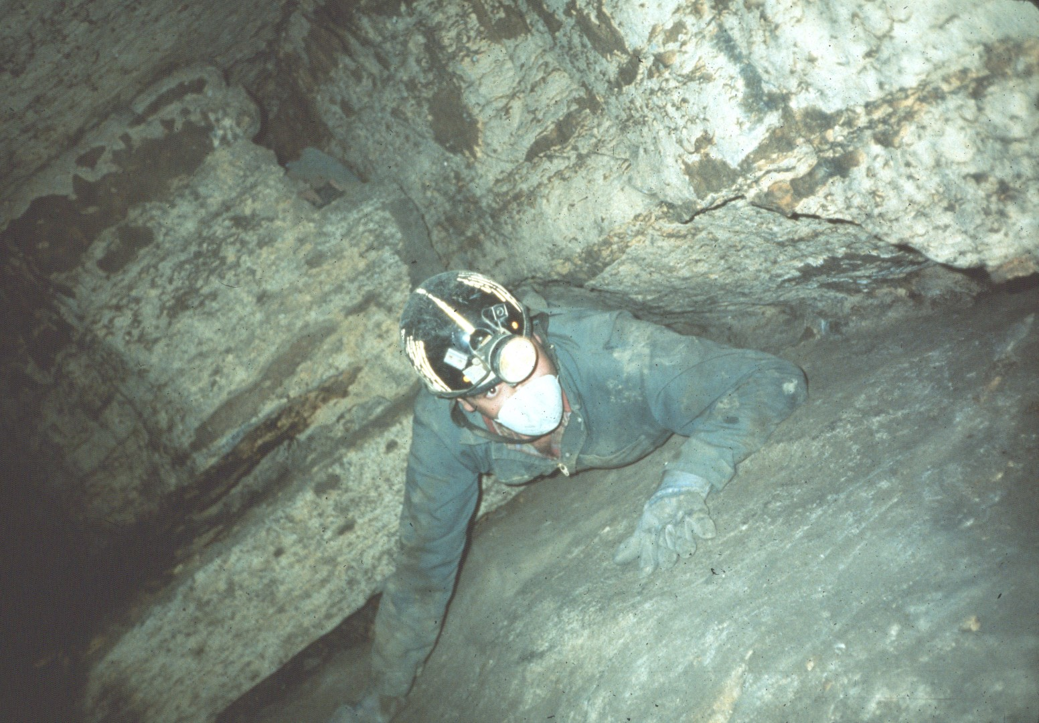
Notes:
Beyond Thrush Hall the bedding plane crack is followed again to more rooms.

Slide 21
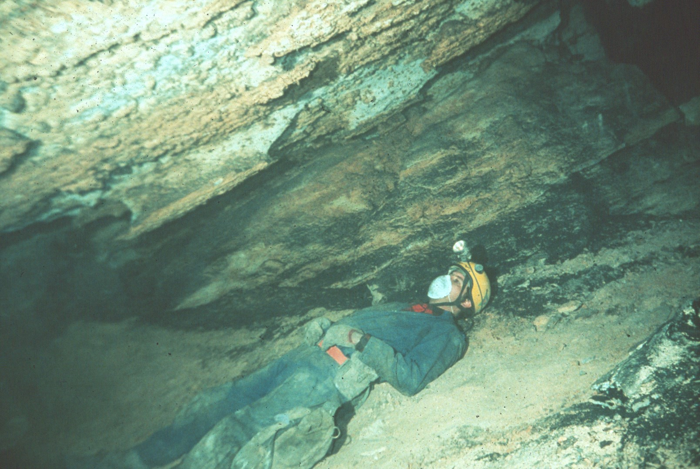
Notes:
The Respite Room is one of the larger rooms in the new section.

Slide 22
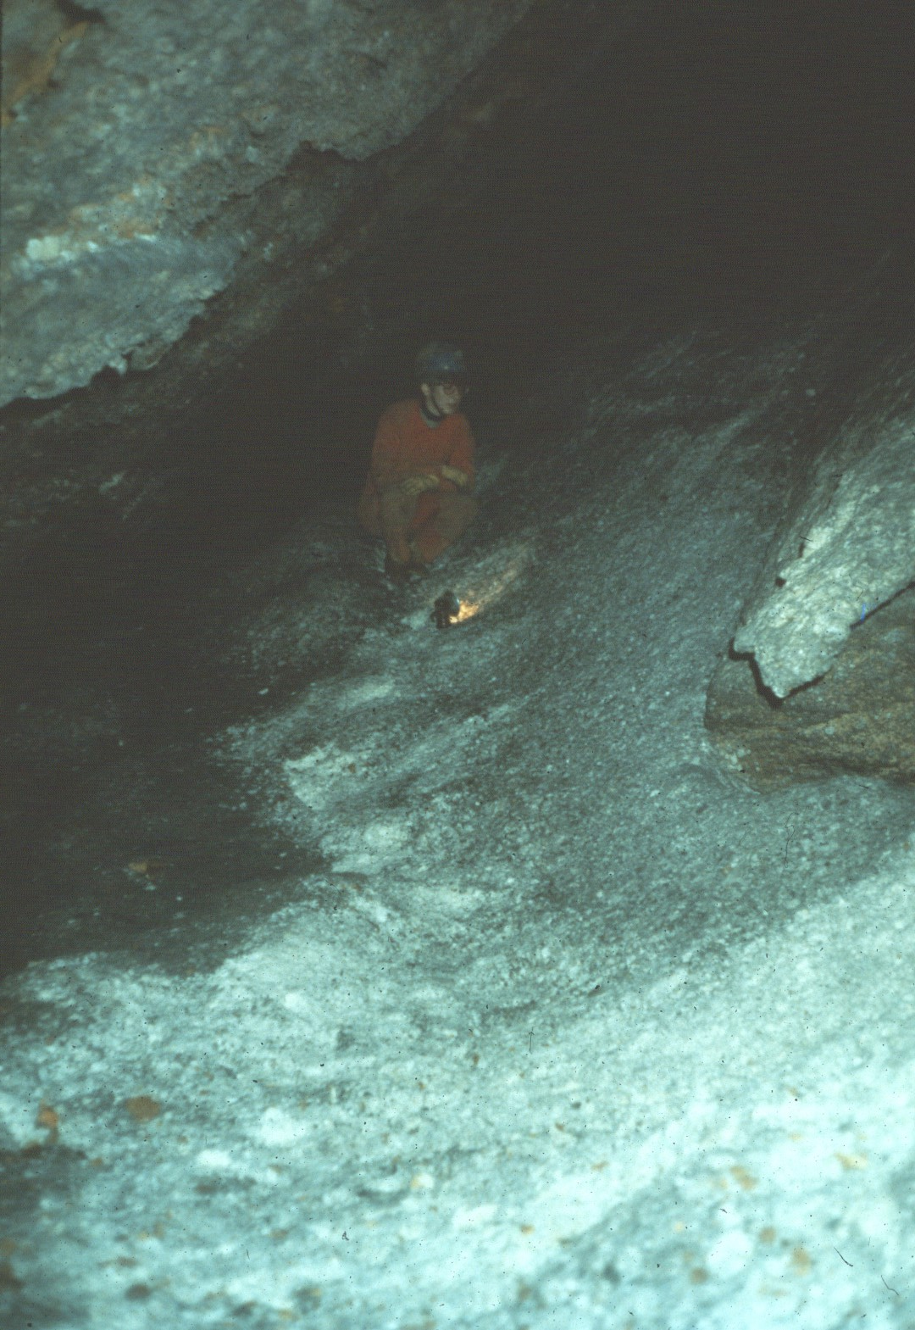
Notes:
Snow Flake Palace can only be reached by very small people.

Slide 23
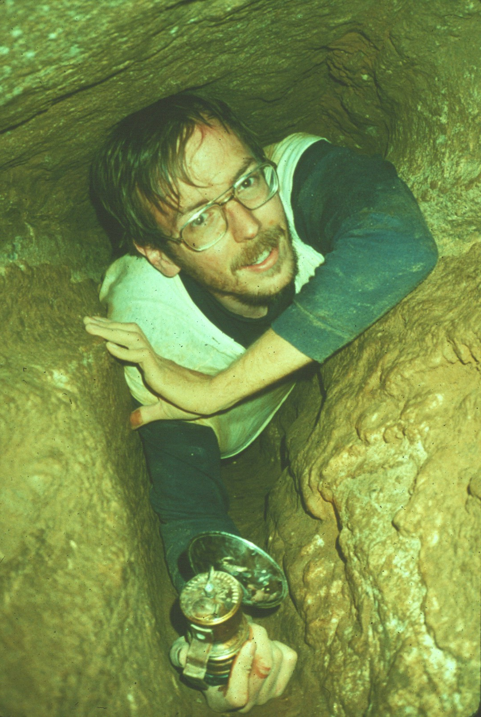
Notes:
Not all of the passage in the new section is large.

Slide 24
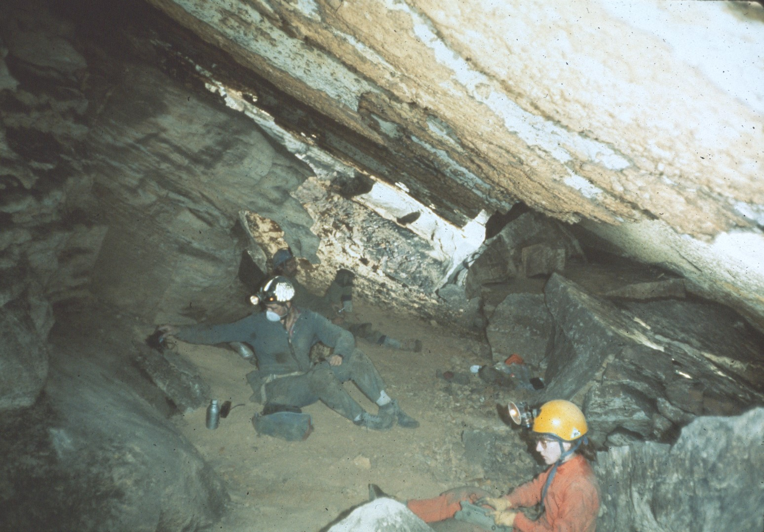
Notes:
Relaxing after the breakdown crawl.

Slide 25
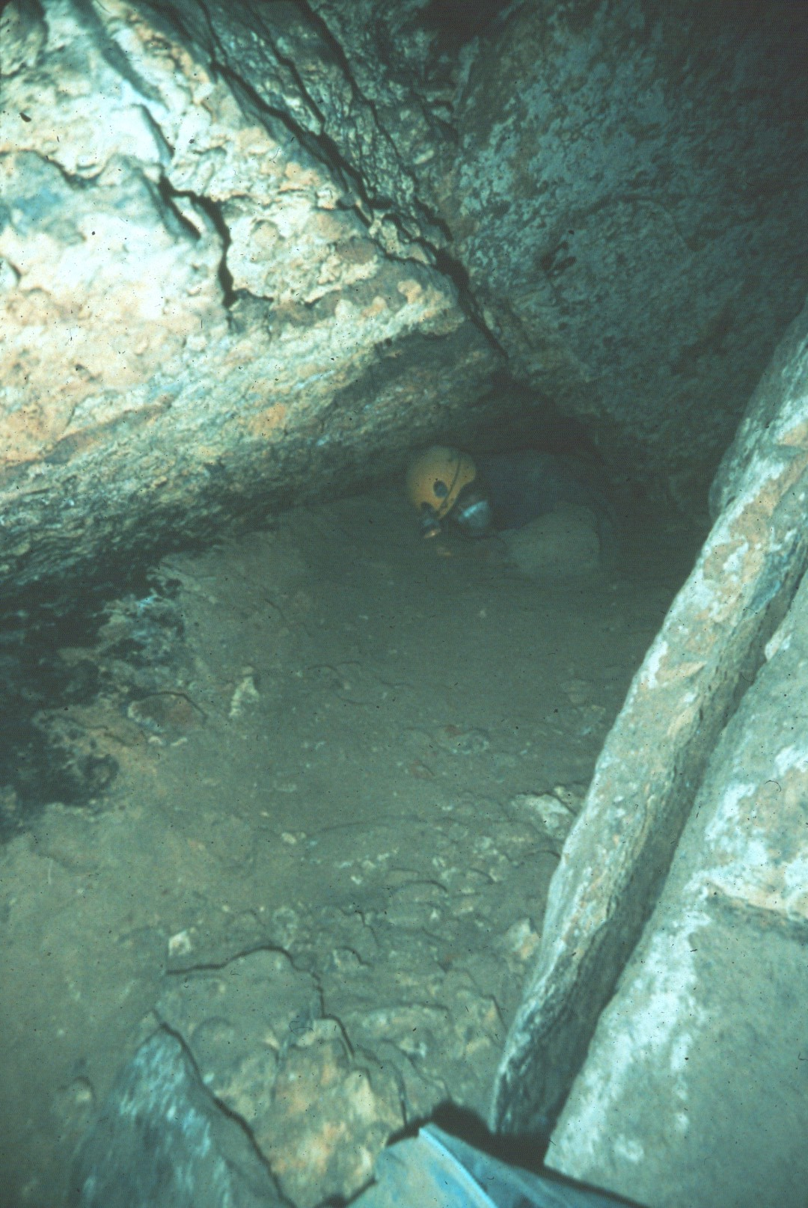
Notes:
Repeated digs were required for further exploration.

Slide 26
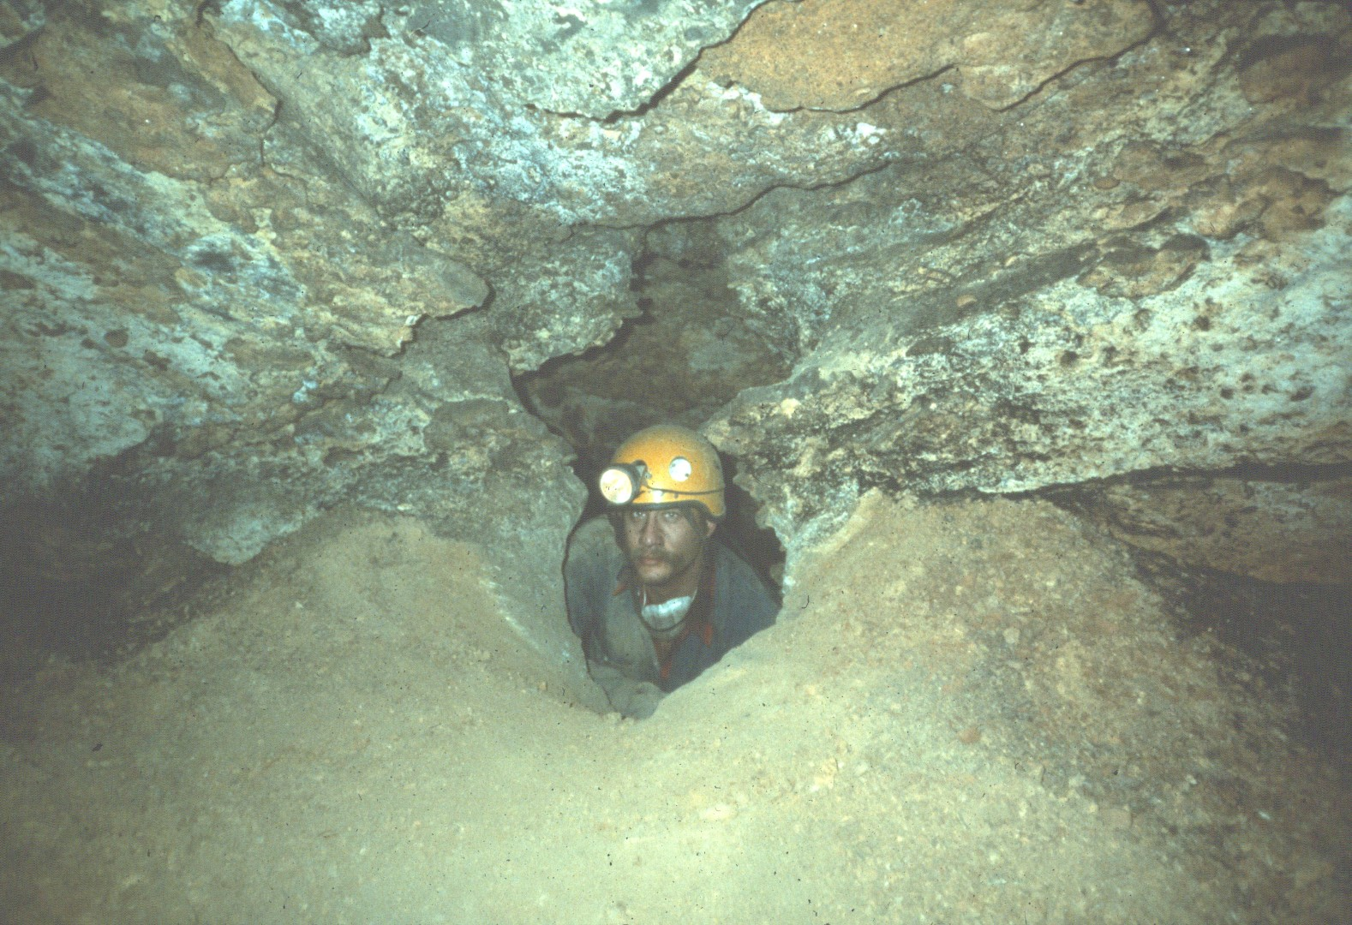
Notes:
A small window between parallel passages led to . . .

Slide 27
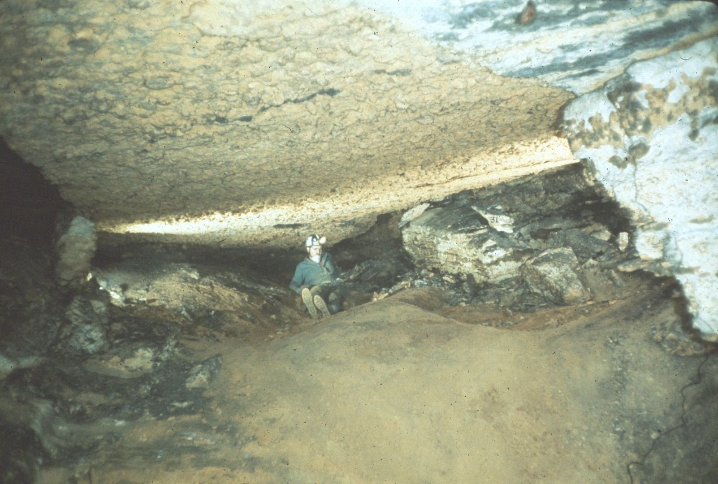
Notes:
Union Station is the largest room in the cave.

Slide 28
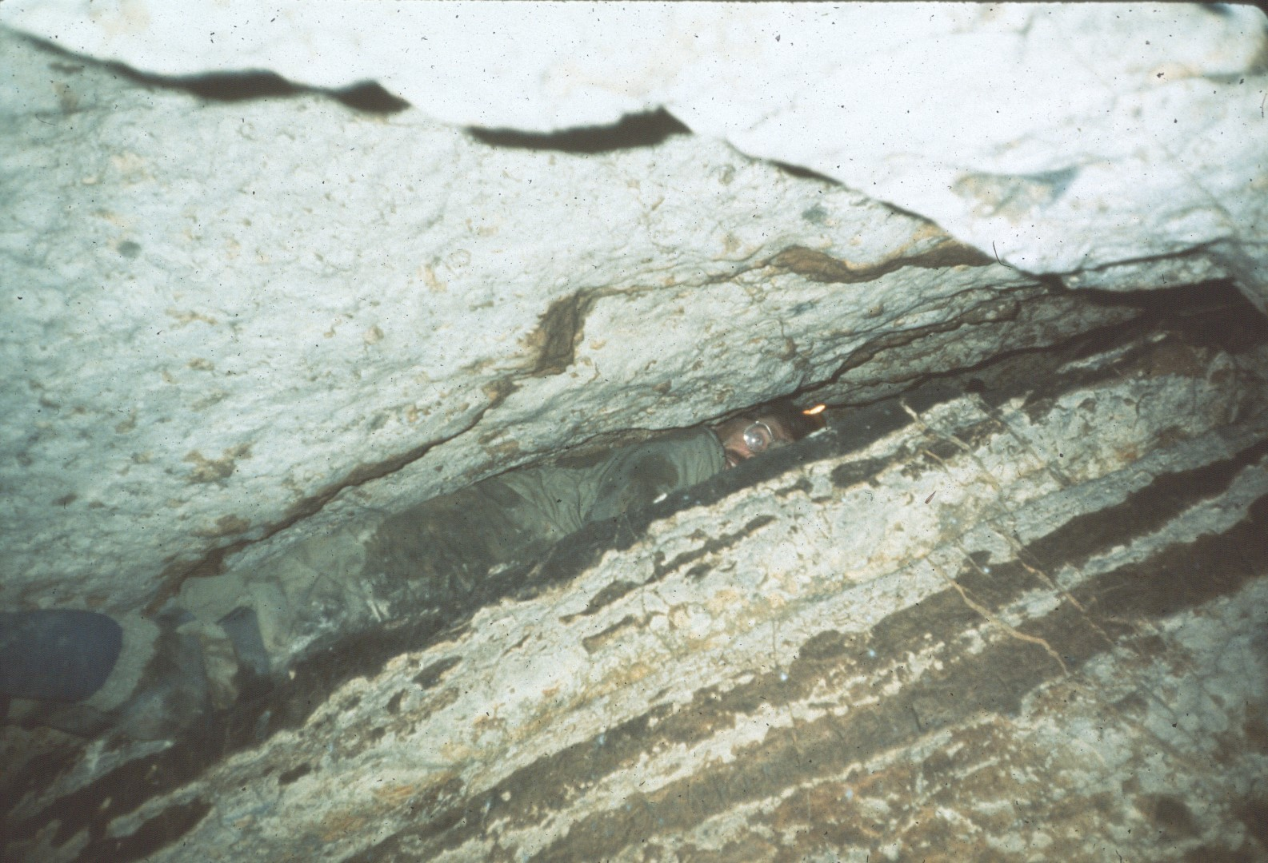
Notes:
Some of the bedding plane cracks did not go far.

Slide 29
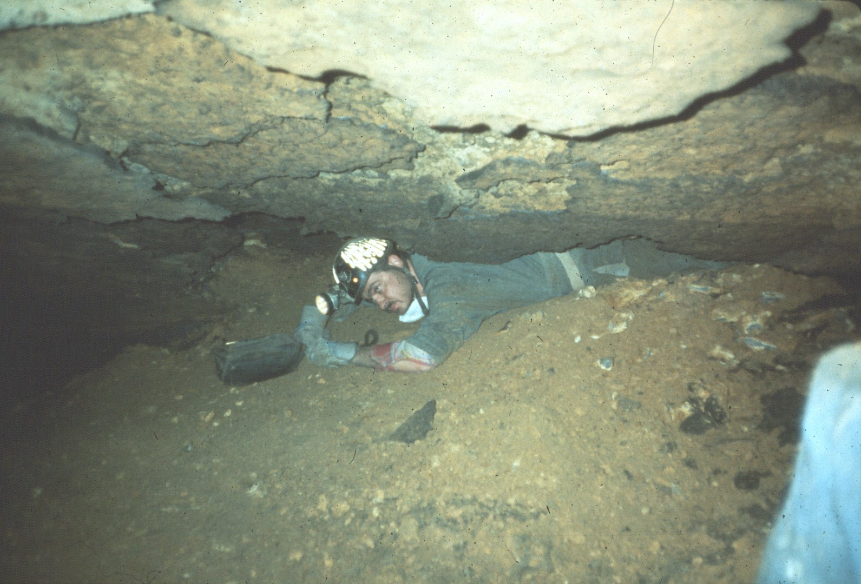
Notes:
Toward the rear of the cave the digs became more and more grim.

Slide 30
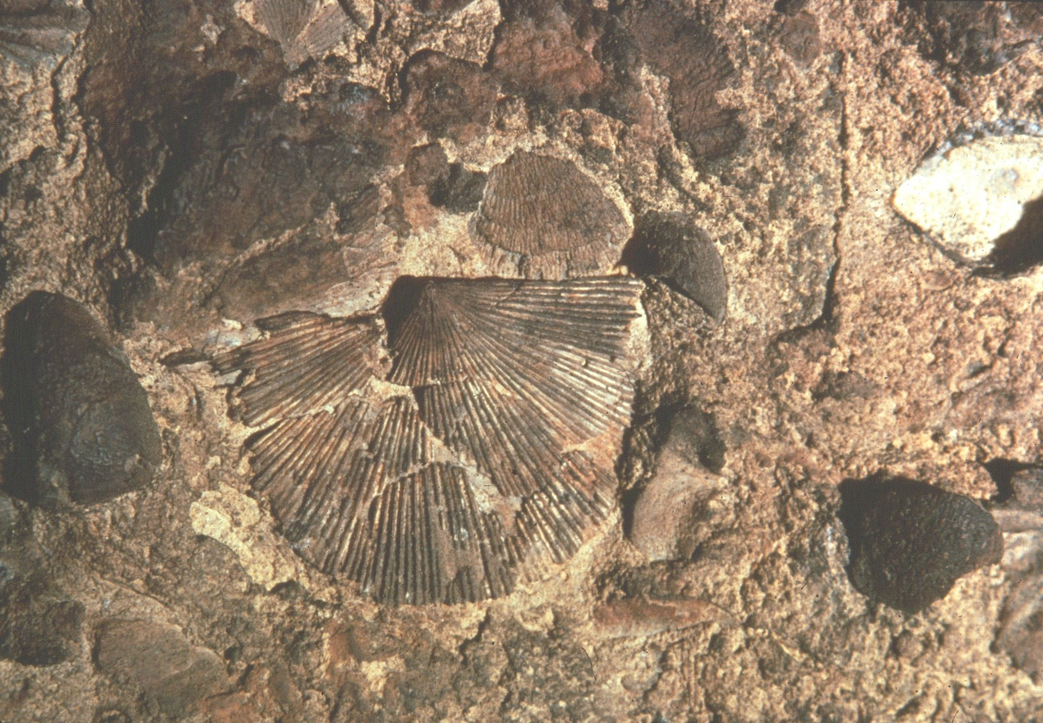
Notes:
Fossil shells on the wall of New Trout.

Slide 31
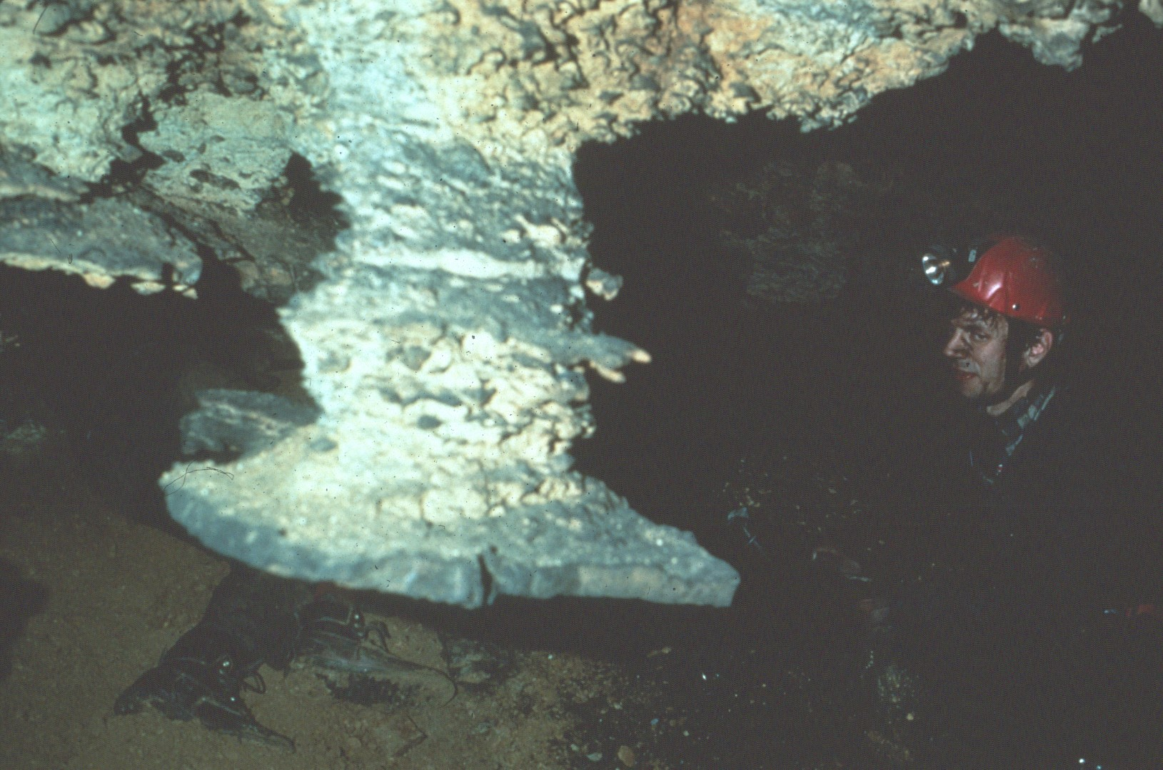
Notes:
Chert layers such as this are seen in all three of the major caves on the preserve.

Slide 32
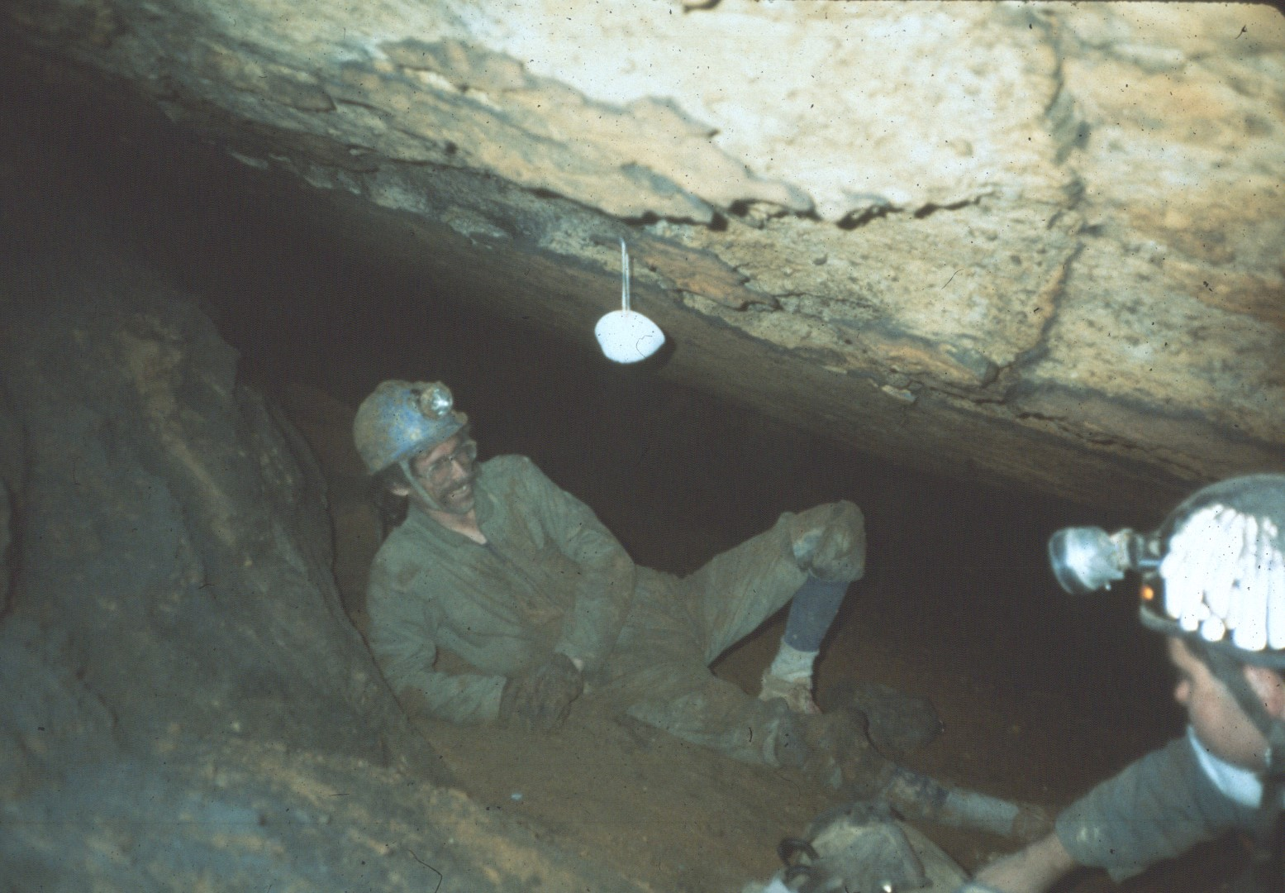
Notes:
Camp Misery in the back of New Trout.

Slide 33
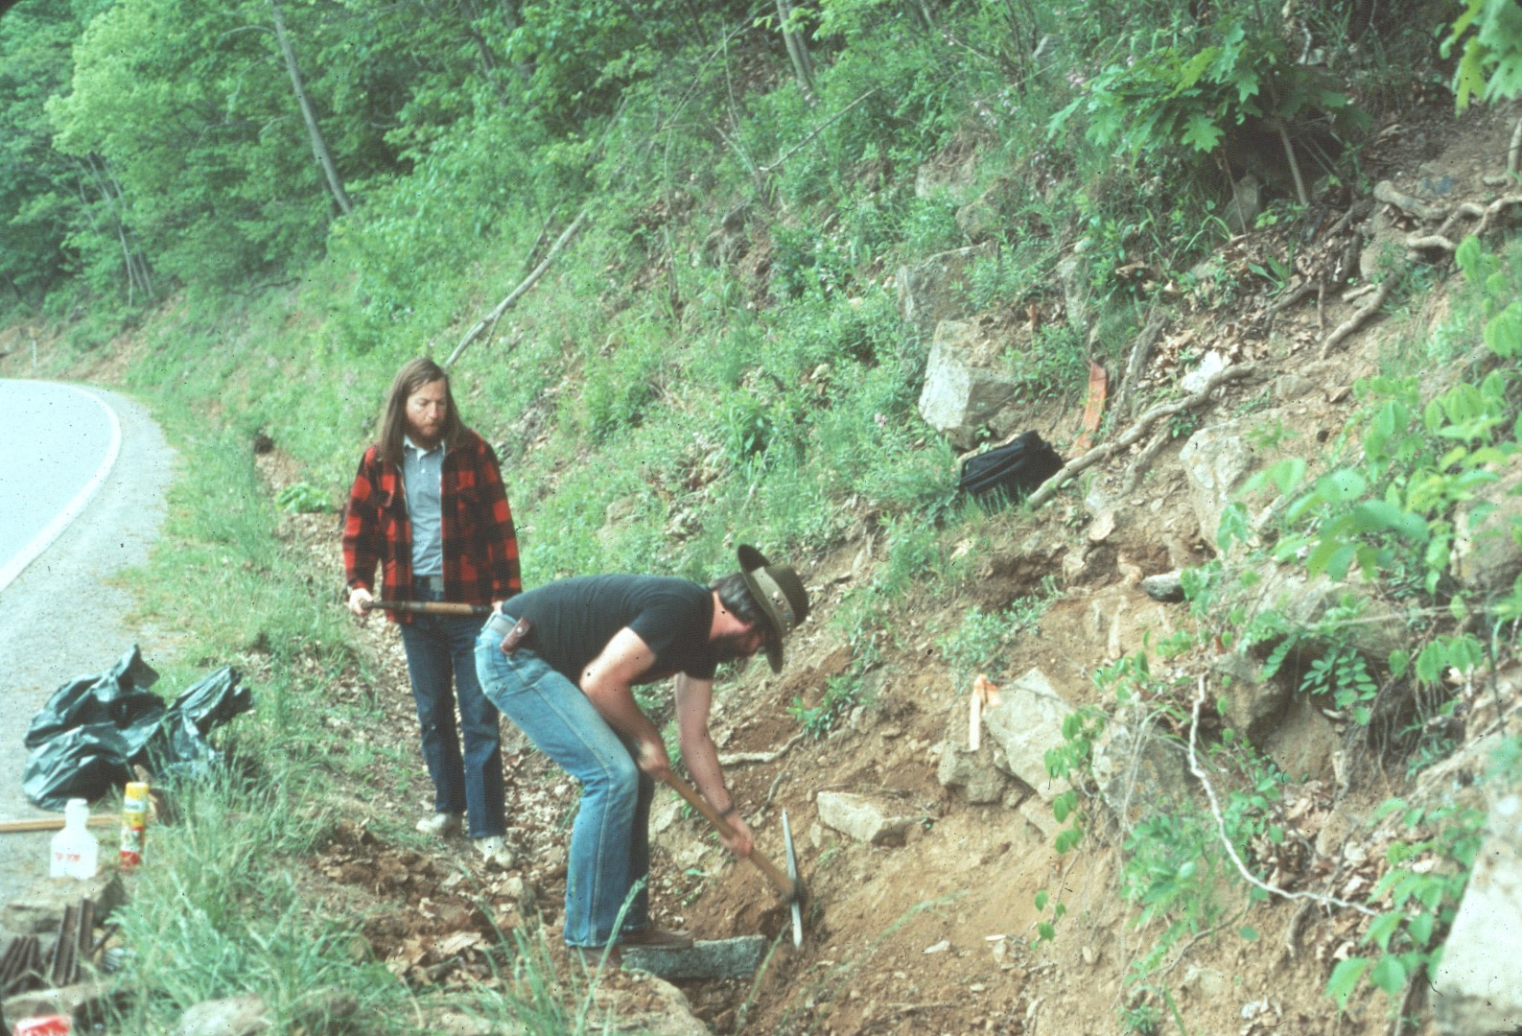
Notes:
In 1983 NSS cavers established a trail to direct traffic on the property.

Slide 34
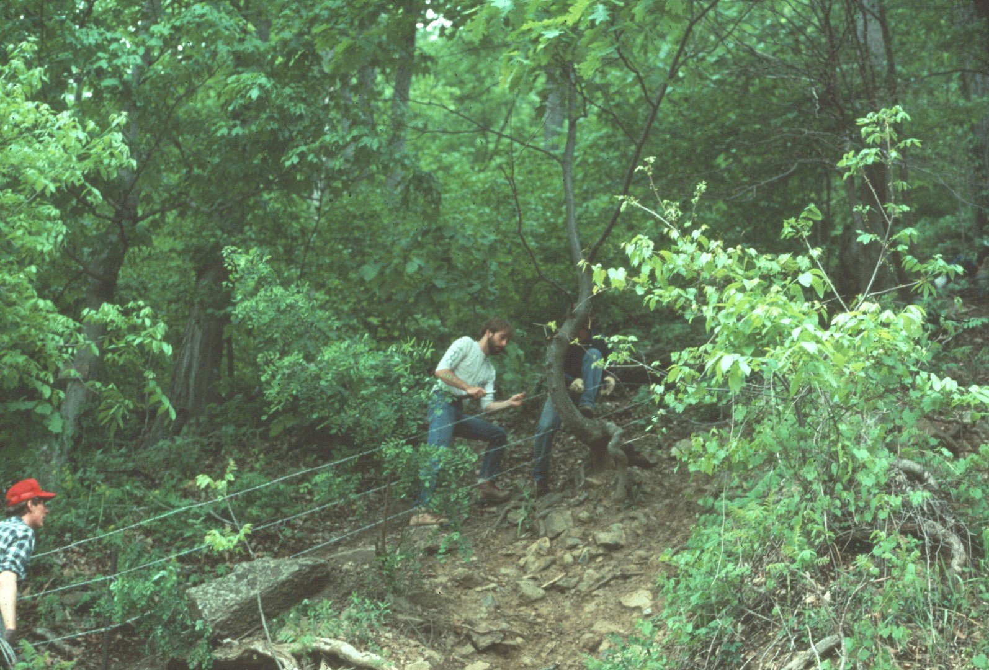
Notes:
Fencing was installed to control erosion on the Steep hill side.

Slide 35
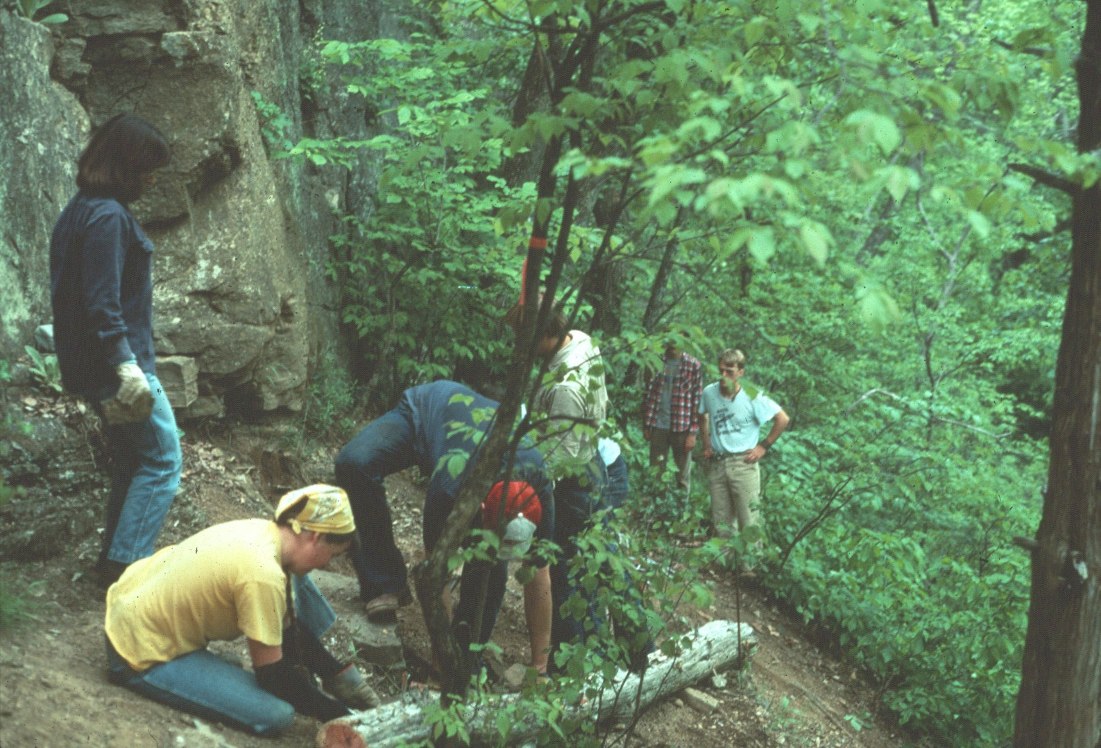
Notes:
Many volunteers assisted in the trail work.

Slide 36
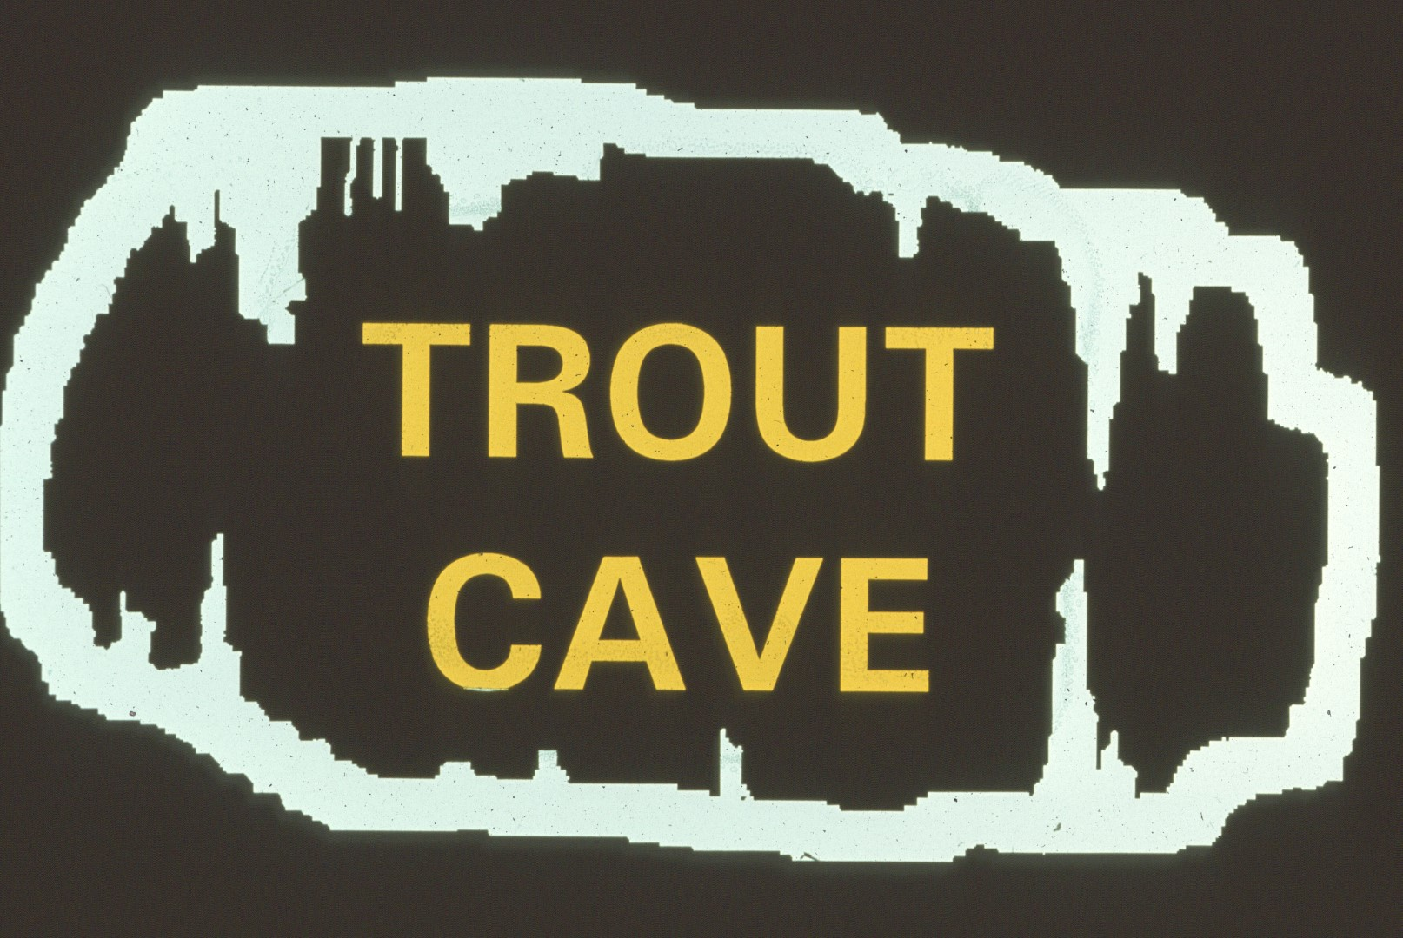
Notes:
The next cave most visitors are likely to see is Trout.

Slide 37
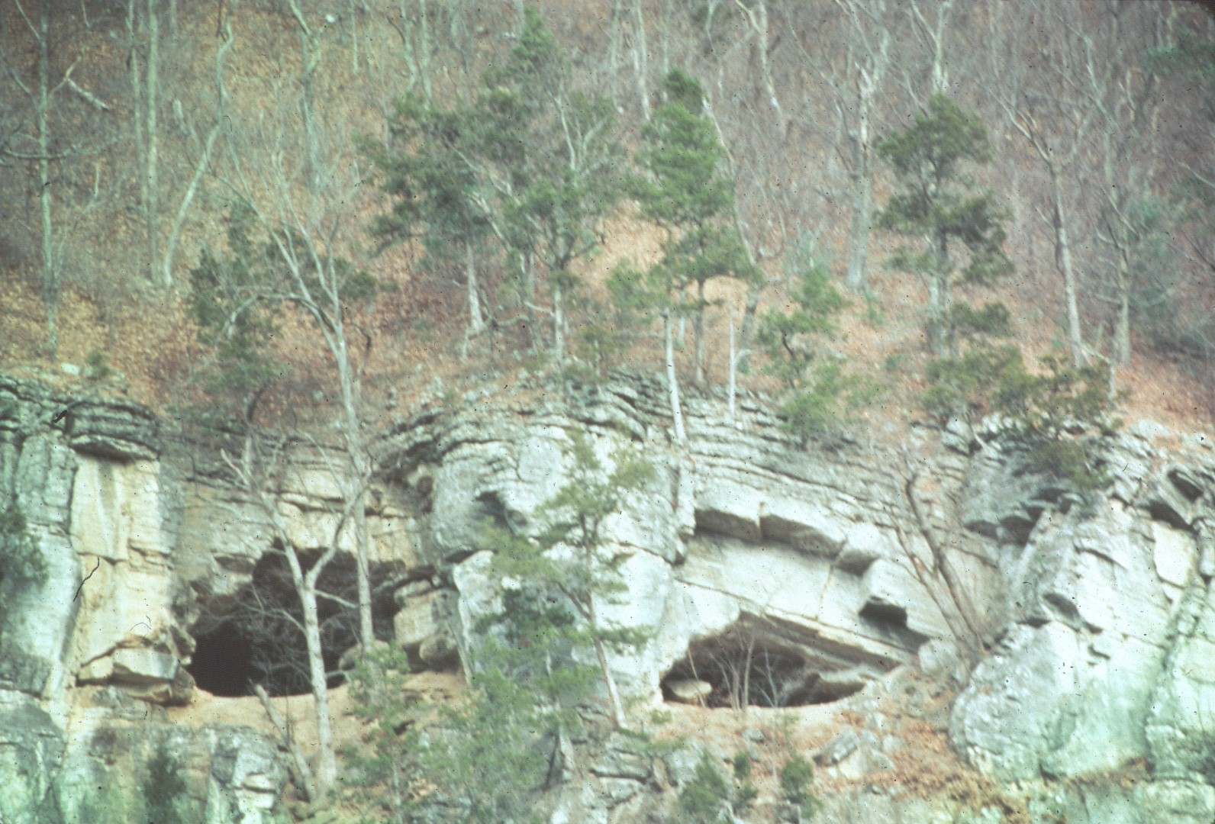
Notes:
Its parallel entrances are easily seen from the highway.

Slide 38
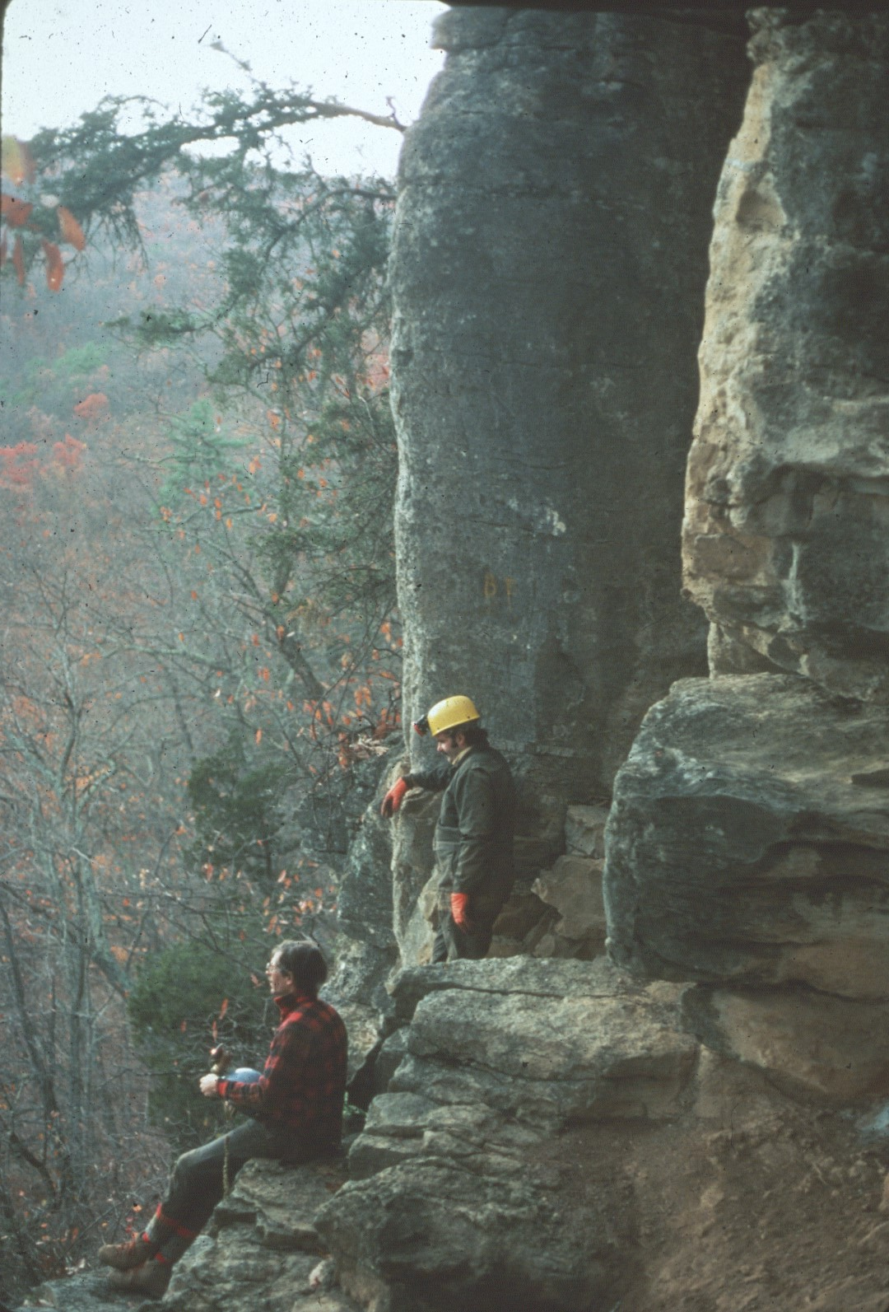
Notes:
Dave West and Tom Kaye were responsible for much of the mapping of the caves on the preserve.

Slide 39
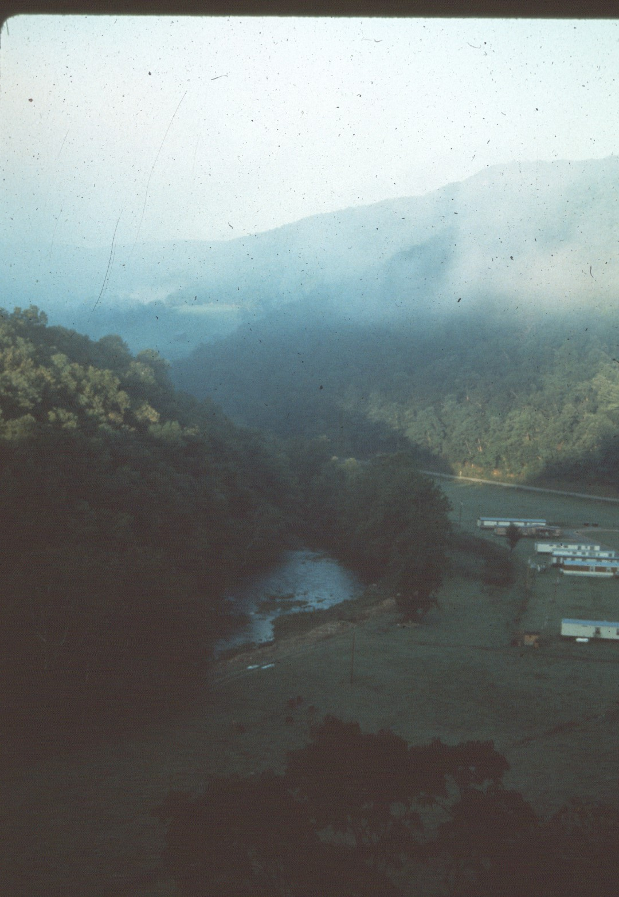
Notes:
The entrance to Trout provides an excellent view of the valley below.

Slide 40
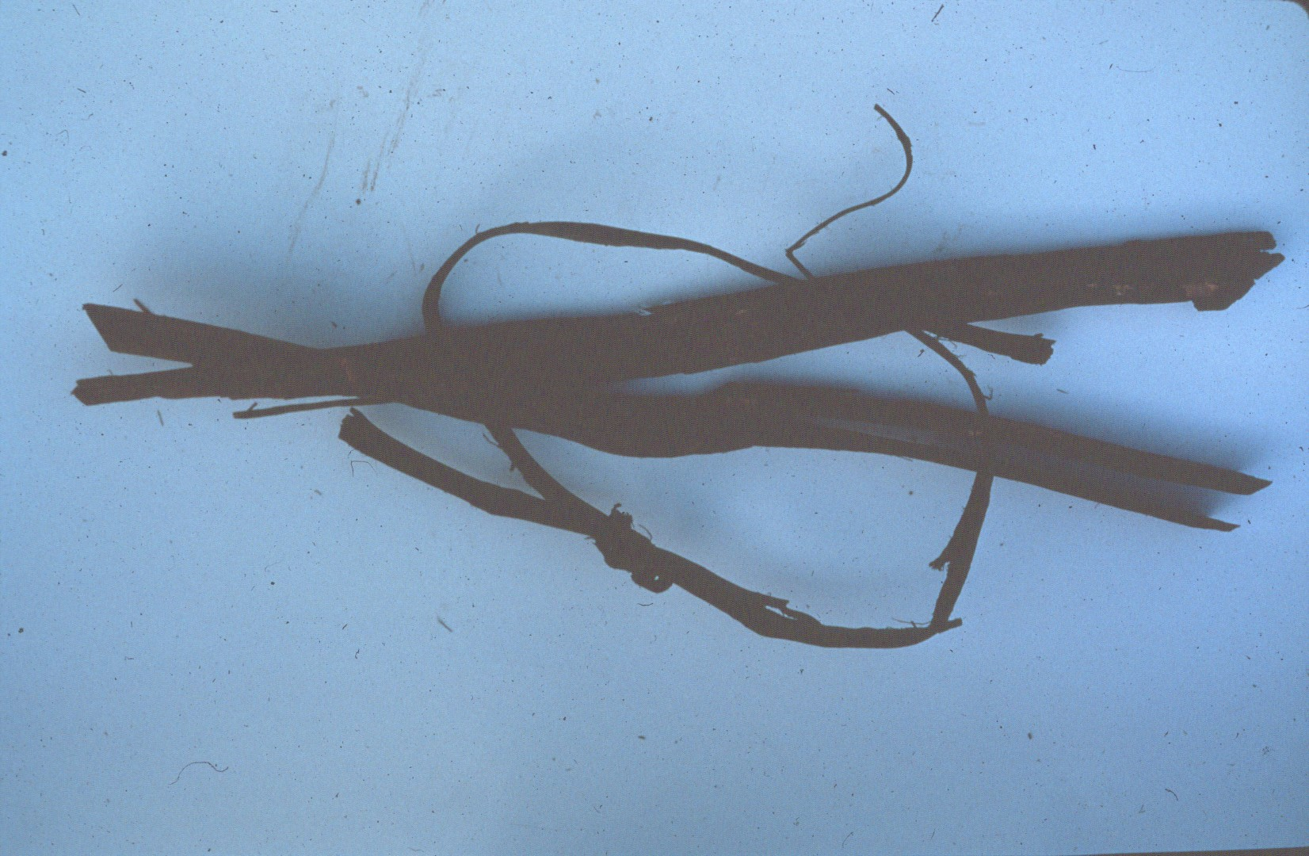
Notes:
Unused faggot torches from salt pet.re mining days.

Slide 41
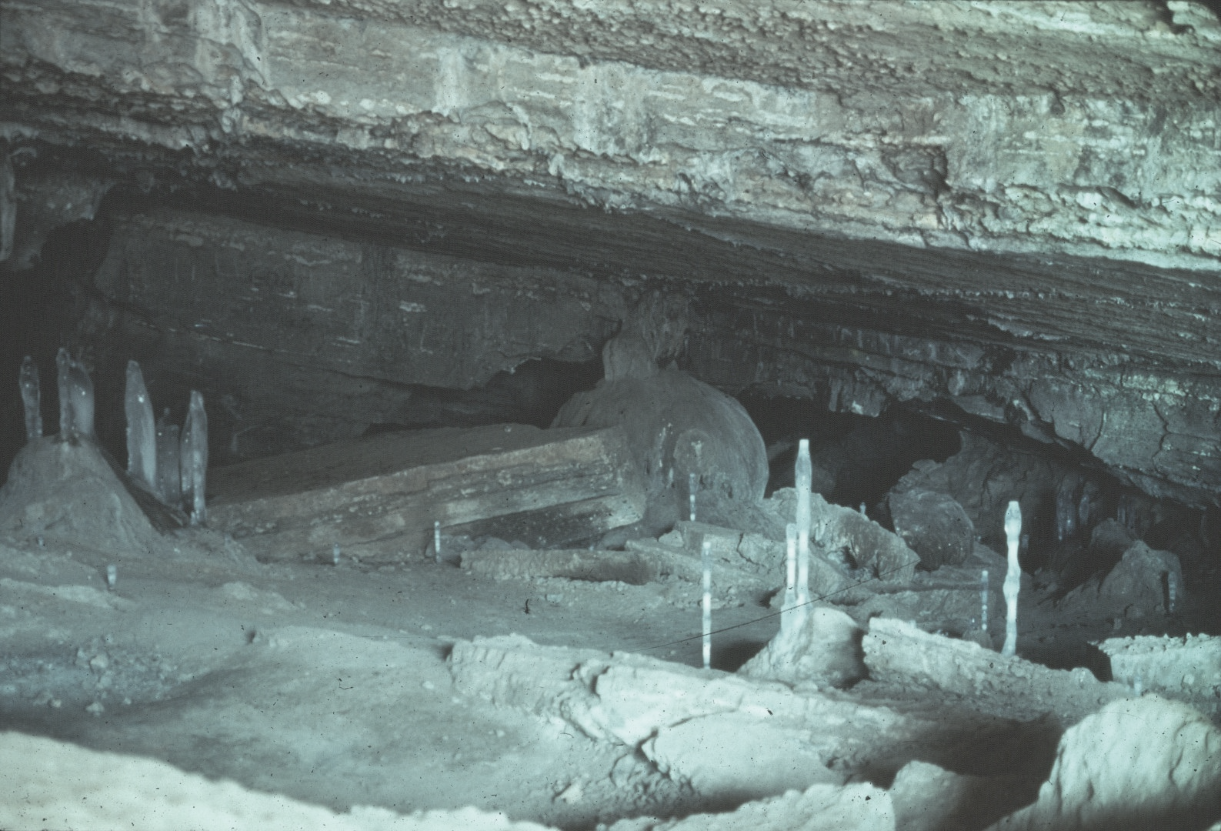
Notes:
Ice formations near the Trout entrance.

Slide 42
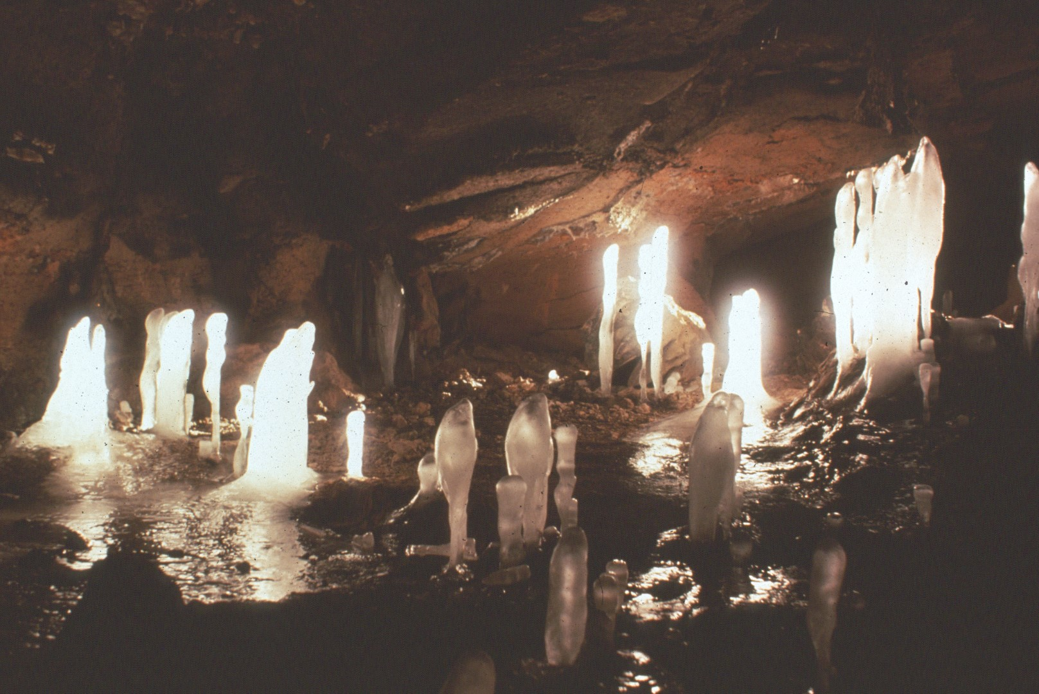
Notes:
More ice formations

Slide 43
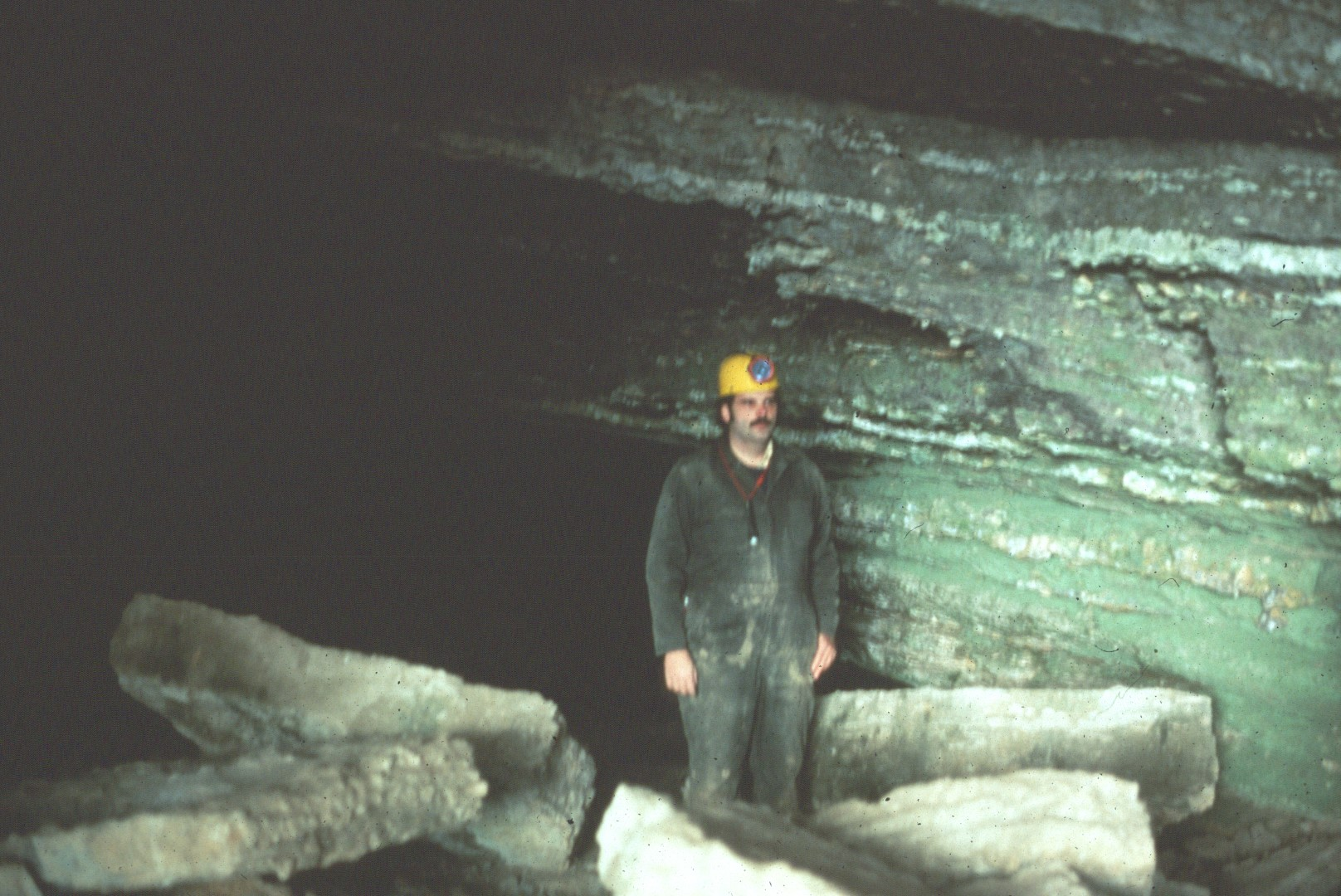
Notes:
Much of Trout is floored with large breakdown.

Slide 44
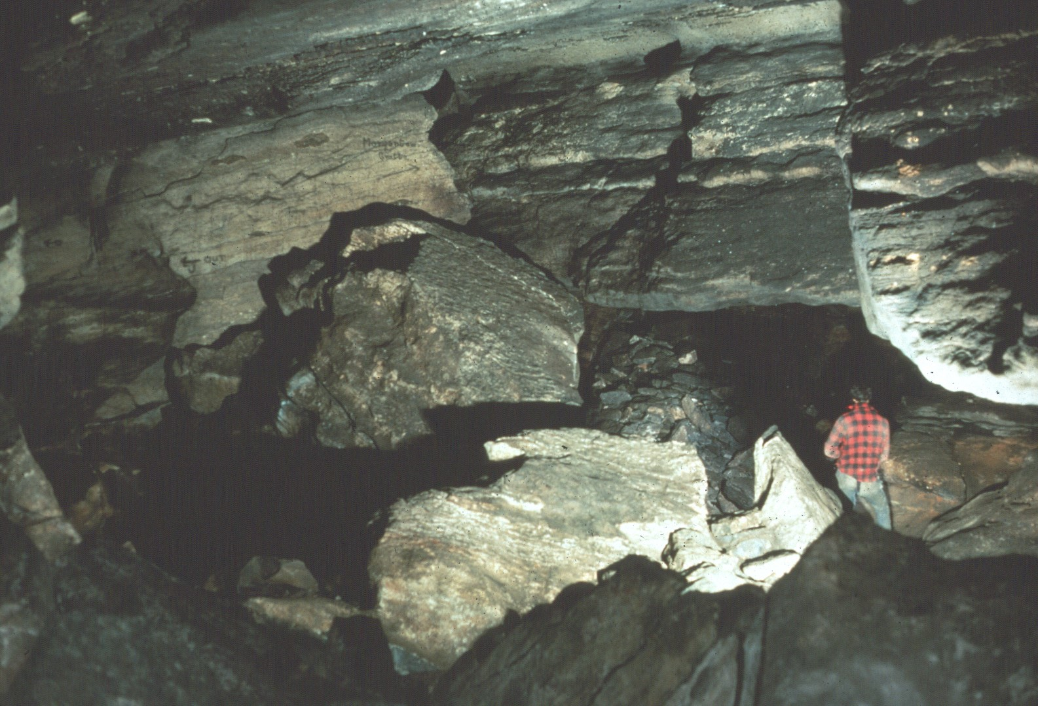
Notes:
Many of the passages are of ample dimensions.

Slide 45
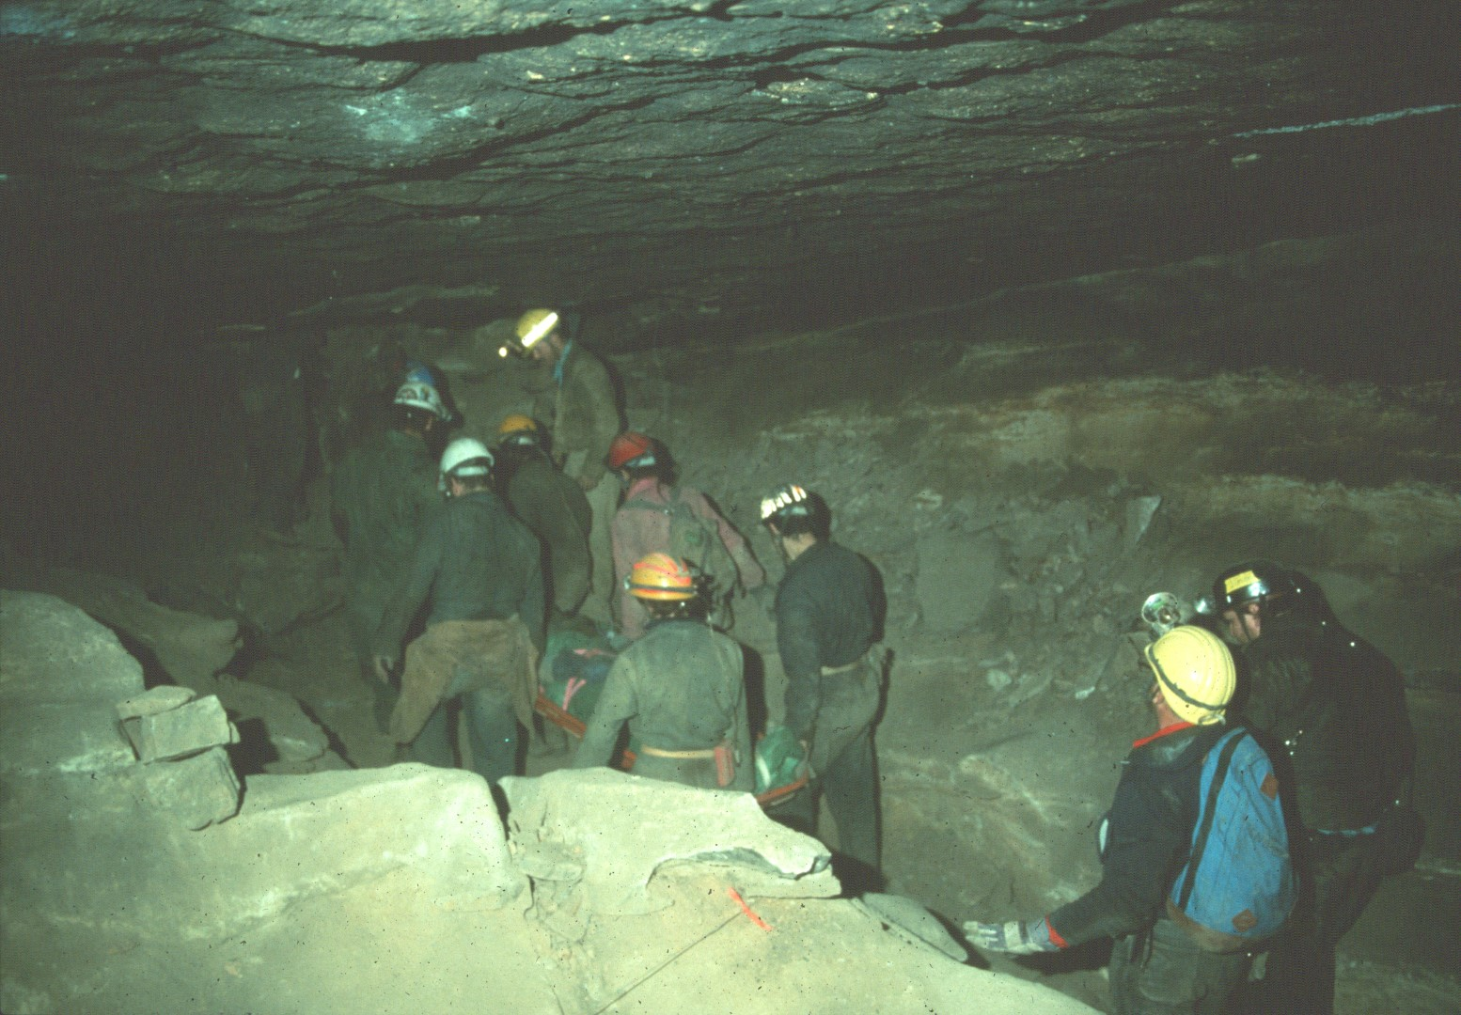
Notes:
Trout has been used for a NCRC rescue simulation.

Slide 46
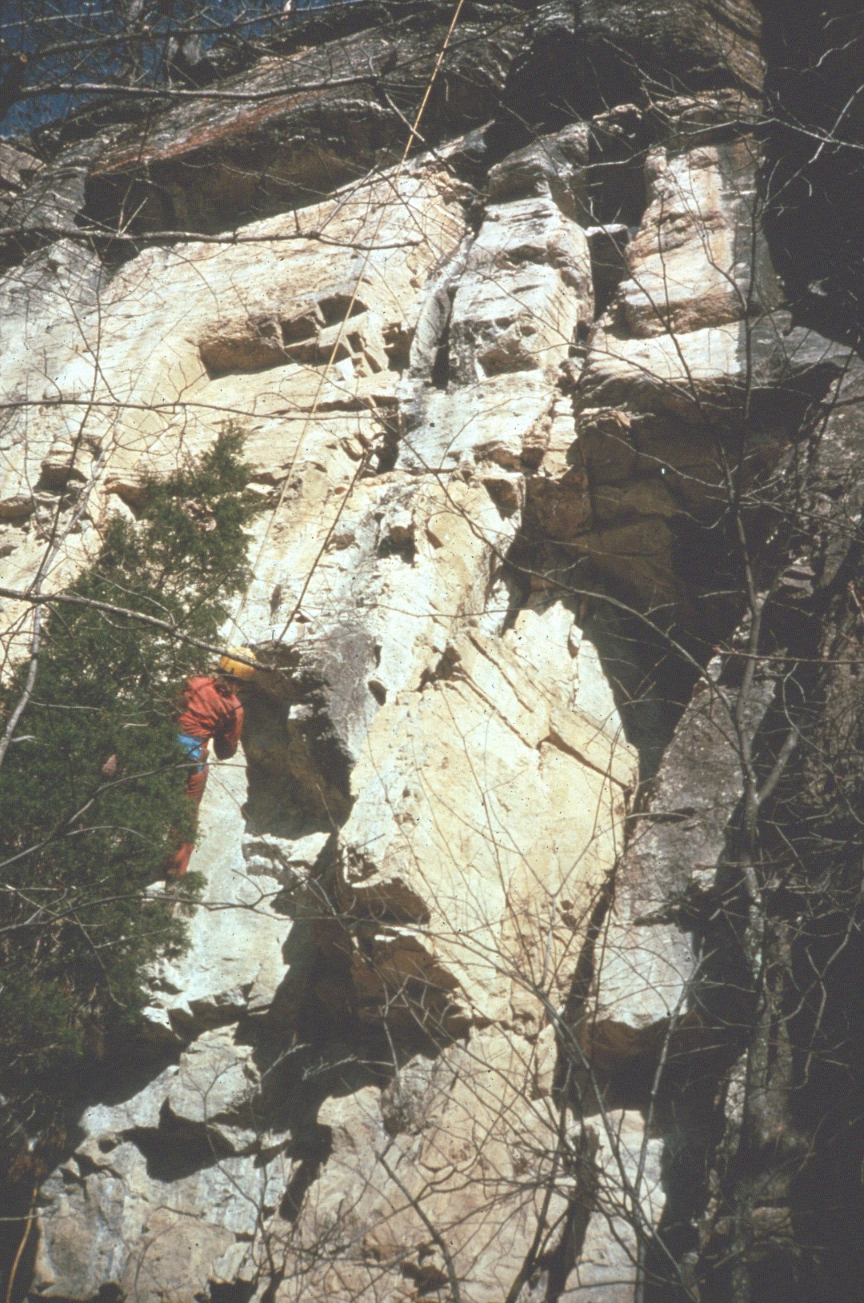
Notes:
There are several apparent small caves on the cliffs of the property. This is Kathy's Crack …

Slide 47
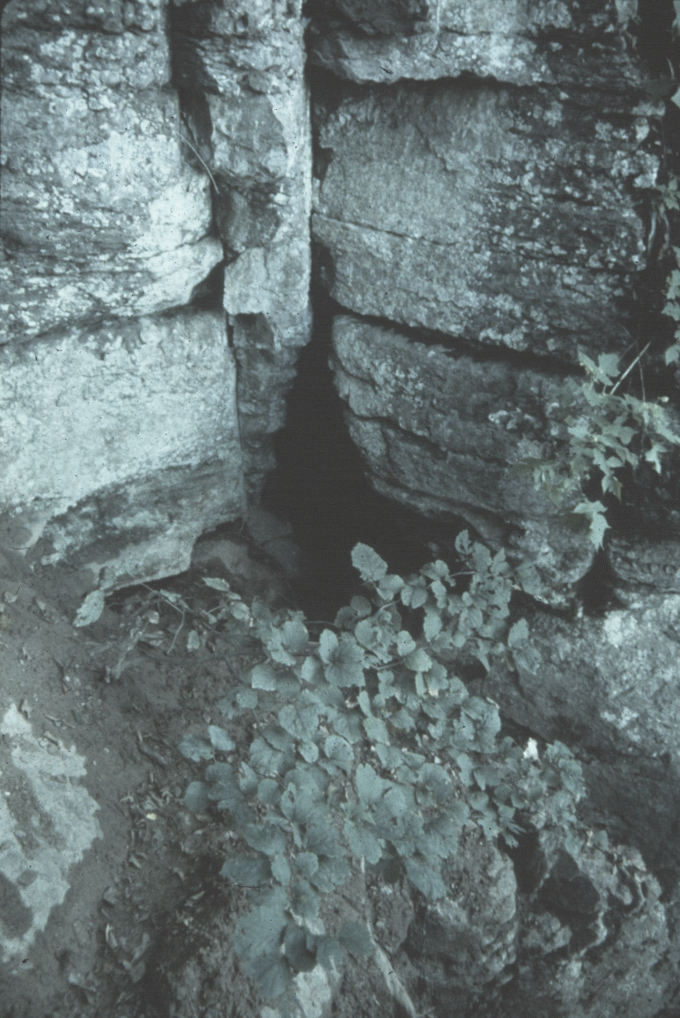
Notes:
and Root Hole.

Slide 48
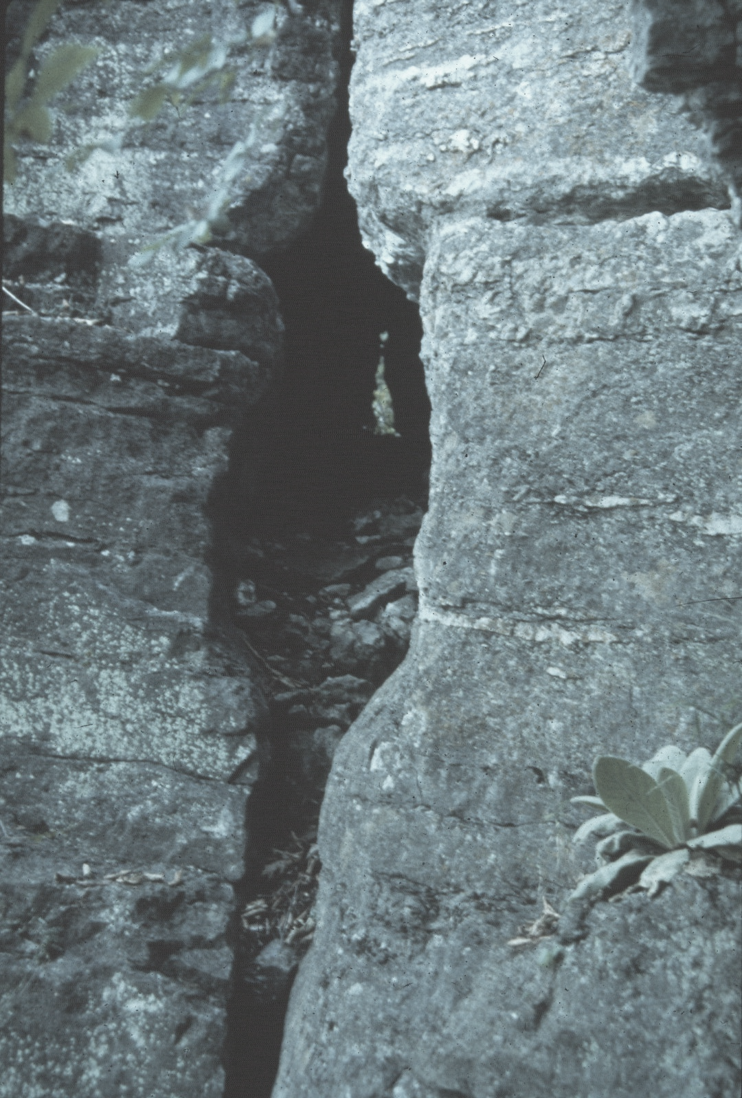
Notes:
In Trammelton a fifty-foot through trip is possible.

Slide 49
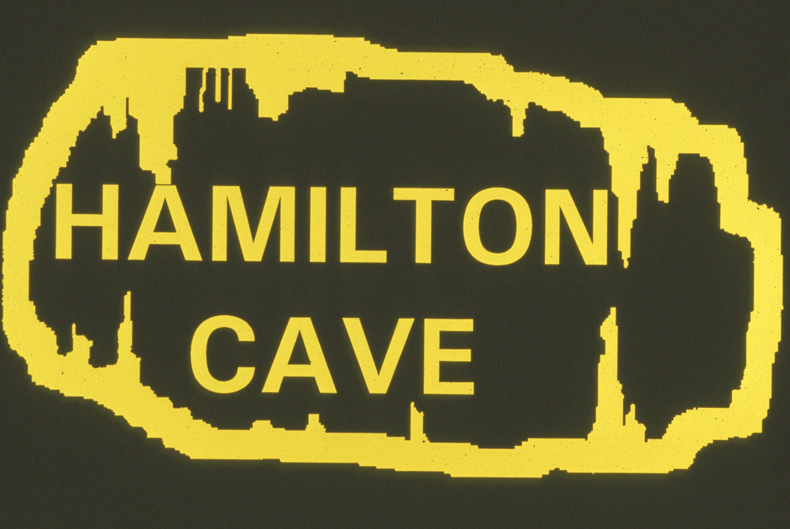
Notes:
The last cave most visitors to the property see is Hamilton.

Slide 50
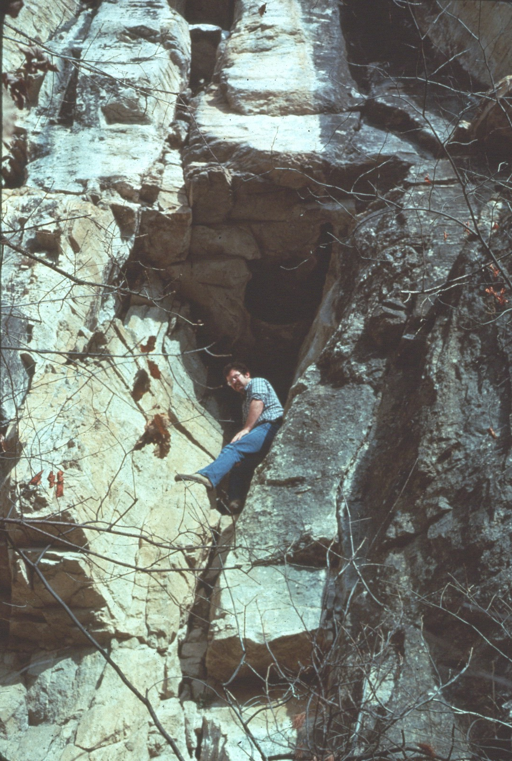
Notes:
Its entrance is smaller than the entrances for the other two caves.

Slide 51
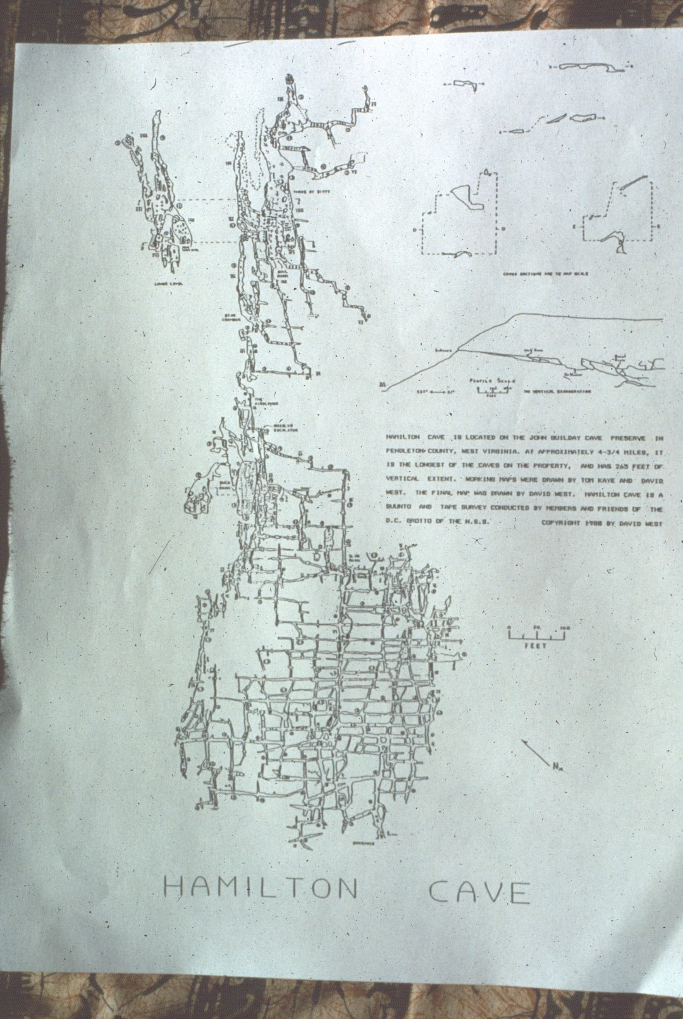
Notes:
Hamilton Cave is the largest cave on the property with over 4. 5 miles of surveyed passage.

Slide 52
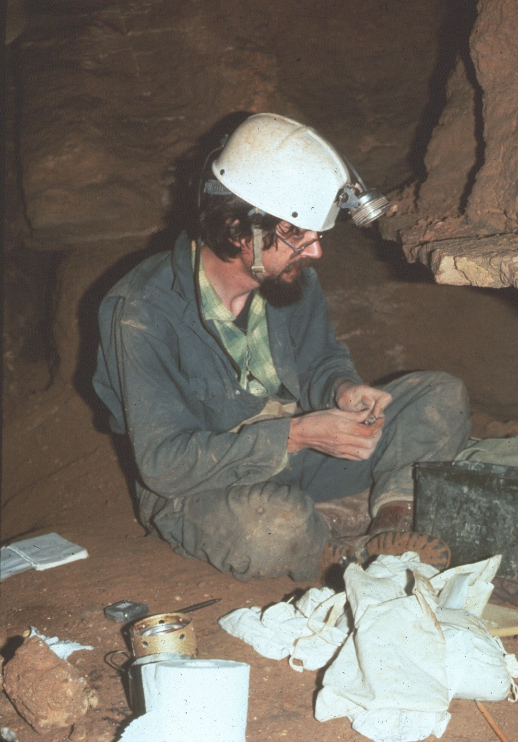
Notes:
Fred Grady discovered significant bone deposits in the cave during the 1970s.

Slide 53
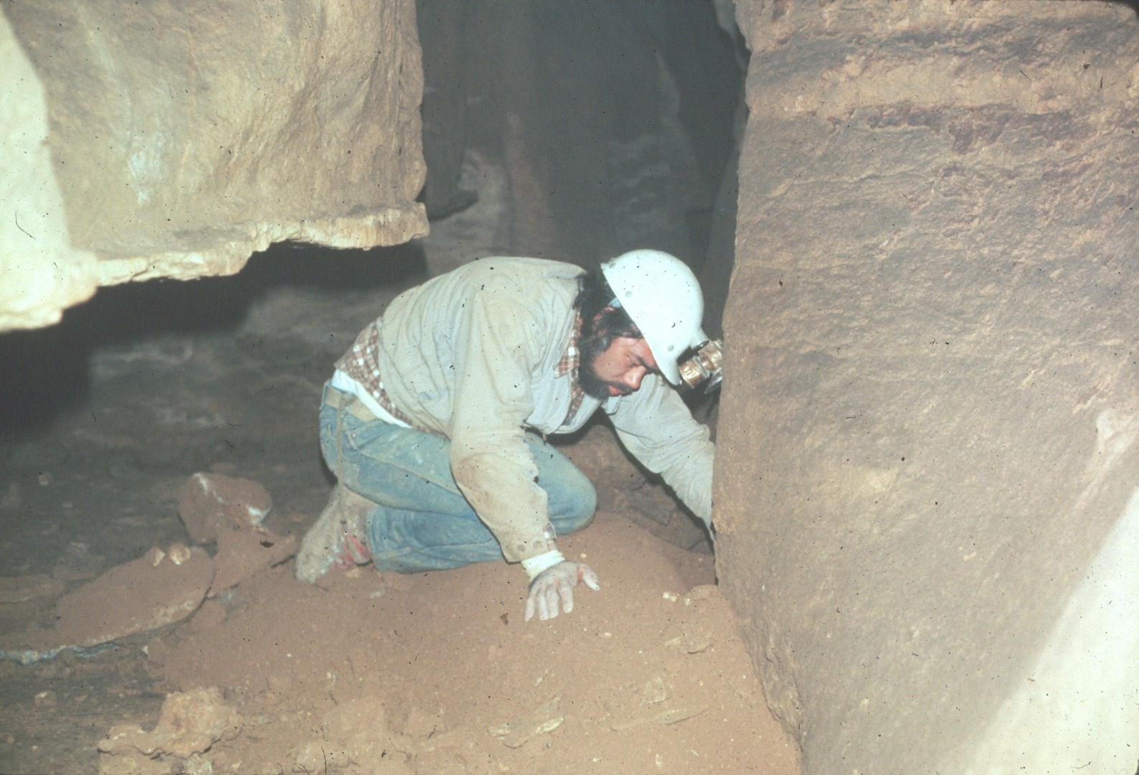
Notes:
Buck Keller assisted Fred and also made several important discoveries.

Slide 54
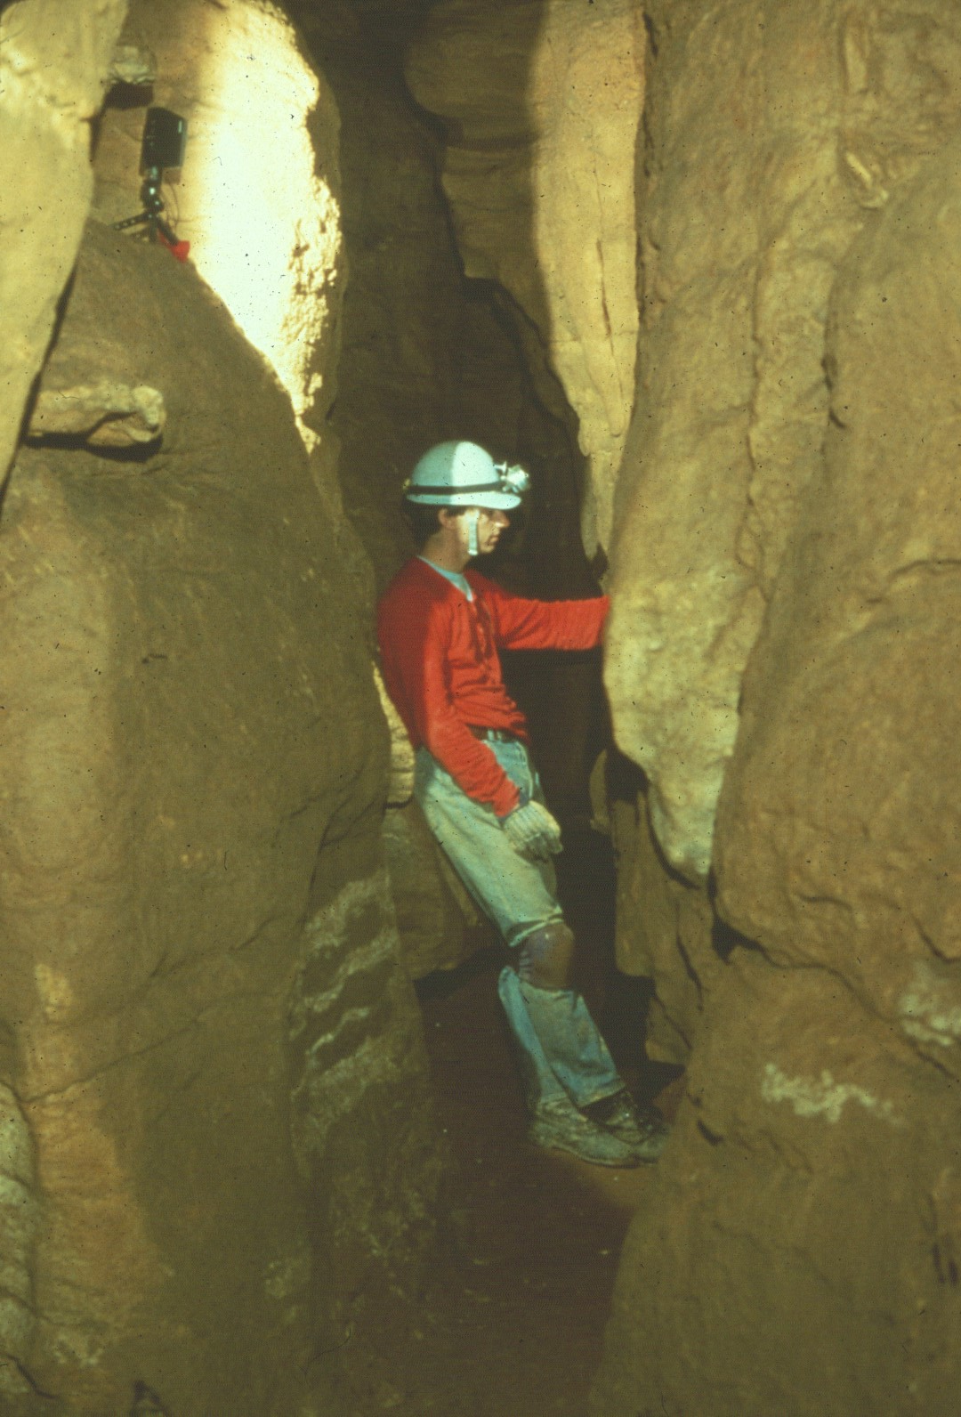
Notes:
Many of the passages near the bone sites are narrow.

Slide 55
Notes:
Among the bones they found was a ne a rly complete skull of a large Jaguar,

Slide 56
Notes:
the upper and lower jaws of an extinct cheetah-like cat,

Slide 57
Notes:
the canine of a sabertoothed cat,

Slide 58
Notes:
the upper and lower teeth of another saber-toothed cat, and

Slide 59
Notes:
the teeth and jaw parts of an extinct peccary related to present day javalinas.

Slide 60
Notes:
Some of the early signatures found in Hamilton Cave date back to the middle 1800's.

Slide 61
Notes:
One of the signatures is that of William McCoy, a former owner of the property.

Slide 62
Notes:
The NSS management committee has photographed the signatures.

Slide 63
Notes:
Hamilton has a few formation areas.

Slide 64
Notes:
Some more formations.

Slide 65
Notes:
but most of the passage is stoop way.

Slide 66
Notes:
In the back of Historic Section of Hamilton is the notorious Air-Blower passage.

Slide 67
Notes:
The Air-Blower is not a passage for large people.

Slide 68
Notes:
Many cavers elect not to try it.

Slide 69
Notes:
Beyond the Air-Blower is the Star Chamber.

Slide 70
Notes:
Followed by the Bowl Room, the largest room in the cave.

Slide 71
Notes:
It's covered by large breakdown.

Slide 72
Notes:
The bottom of the Bowl Room is the deepest point in Hamilton cave.

Slide 73
Notes:
This historic marker was posted along the highway in front of the property for many years, but it was washed away by a major flood in November 1985.

Slide 74
Notes:
The flood also uncovered NSS Flood Cave.

Slide 75
Notes:
Its entrance is in a stream bank.

Slide 76
Notes:
and is extremely tight.

Slide 77
Notes:
The cave is the most decorated one on the property.

Slide 78
Notes:
However, it has very little walking passage.

Slide 79
Notes:
Some of its passages have never been entered to avoid damaging the formations.

Slide 80
Notes:
Recreational trips to NSS Flood Cave are discouraged to protect its many delicate features.

Slide 81
An NSS Audio-Visual Library Presentation
John Guilday Cave Preserve
By the Guilday Cave Preserver Management Committee (1992)
Original slide program S628
Slides digitized by David Caudle
PowerPoint program created by David Socky
81 slides, with script in presenter notes
PowerPoint created 2/4/2021
National Speleological Society
6001 Pulaski Pike
Huntsville, AL 35810-1122
256- 852-1300
nss@caves.org
https://caves.org/
Notes:
The preceding program was produced by the NSS John Guilday Cave Preserve Management Committee using slides provided by Barry Chute, Don Glasko, Fred Grady, Tom Kaye, Steve Swanson, and Dave West.

